Slide 1
ARISTOTLE UNIVERSITY OF THESSALONIKI
FACULTY OF SCIENCES
DEPARTMENT OF MATHEMATICS
Cryptography Based on Learning With Errors
Florias Papadopoulos
Thessaloniki, 21 December 2023
Notes:
Citations for everything can be found on the accompanying thesis.

Slide 2
Cryptographic Schemes
Symmetric Cryptosystem
Public-Key Encryption (PKE) Scheme
Key Encapsulation Mechanism (KEM)
Cryptography Based on Learning With Errors
Florias Papadopoulos
Notes:
1. Γιατί KEM και όχι PKE?
In cryptographic protocols, a key encapsulation mechanism (KEM) or key encapsulation method is used to secure symmetric key material for transmission using asymmetric (public-key) algorithms. It is commonly used in hybrid cryptosystems. In practice, public key systems are clumsy to use in transmitting long messages. Instead they are often used to exchange symmetric keys, which are relatively short. The symmetric key is then used to encrypt the longer message. The traditional approach to sending a symmetric key with public key systems is to first generate a random symmetric key and then encrypt it using the chosen public key algorithm. The recipient then decrypts the public key message to recover the symmetric key. As the symmetric key is generally short, padding is required for full security and proofs of security for padding schemes are often less than complete.^{[1]} KEMs simplify the process by generating a random element in the finite group underlying the public key system and deriving the symmetric key by hashing that element, eliminating the need for padding. 2. KEM vs KEX and AKE Nowadays, in most of our connections, we do not use KEMs or PKEs per se. We either use Key Exchanges (KEXs) or Authenticated Key Exchanges (AKE). The reason for this is that a KEX allows us to use public keys (solving the key exchange problem of how to securely transmit keys) in order to generate a shared/symmetric key which, in turn, will be used in a symmetric encryption algorithm to encrypt data efficiently. A famous KEX algorithm is Diffie-Hellman, but classical Diffie-Hellman based mechanisms do not provide security against a quantum adversary; post-quantum KEMs do.

Slide 3
Provable Security of Cryptographic Schemes
Protocol P
We want to show that
Assumption
(Protocol is semantically secure)
Adversary A
$∃ e$fficient algorithm that breaks assumption
$$⇒$$
$∃ e$fficient algorithm that breaks a problem S
only negligible information about the message can be extracted from the ciphertext
Then, breaking the assumption is also (believed to be) hard
$$⇒$$
If S is (believed to be) computationally hard
The “security” of P is based on the hardness of problem S.
Cryptography Based on Learning With Errors
Florias Papadopoulos
Notes:
1. Γιατί KEM και όχι PKE?
In cryptographic protocols, a key encapsulation mechanism (KEM) or key encapsulation method is used to secure symmetric key material for transmission using asymmetric (public-key) algorithms. It is commonly used in hybrid cryptosystems. In practice, public key systems are clumsy to use in transmitting long messages. Instead they are often used to exchange symmetric keys, which are relatively short. The symmetric key is then used to encrypt the longer message. The traditional approach to sending a symmetric key with public key systems is to first generate a random symmetric key and then encrypt it using the chosen public key algorithm. The recipient then decrypts the public key message to recover the symmetric key. As the symmetric key is generally short, padding is required for full security and proofs of security for padding schemes are often less than complete.^{[1]} KEMs simplify the process by generating a random element in the finite group underlying the public key system and deriving the symmetric key by hashing that element, eliminating the need for padding. 2. KEM vs KEX and AKE Nowadays, in most of our connections, we do not use KEMs or PKEs per se. We either use Key Exchanges (KEXs) or Authenticated Key Exchanges (AKE). The reason for this is that a KEX allows us to use public keys (solving the key exchange problem of how to securely transmit keys) in order to generate a shared/symmetric key which, in turn, will be used in a symmetric encryption algorithm to encrypt data efficiently. A famous KEX algorithm is Diffie-Hellman, but classical Diffie-Hellman based mechanisms do not provide security against a quantum adversary; post-quantum KEMs do.

Slide 4
Computationally Hard Problems: Today and Beyond
Problems used in Modern Cryptography
Integer Factorization
Discrete Logarithm Problem (DLP)
Elliptic Curve Discrete Logarithm Problem (ECDLP)
RSA, Rabin Cryptosystem
Elliptic-curve Diffie–Hellman (ECDH)
Diffie-Hellman Key Exchange
Problems used in Post-Quantum Cryptography
Hard Problems in Lattices (SIS, LWE -> SVP, CVP)
Finding solutions of multivariate equations
Problem in isogenies of graphs of elliptic curves on finite fields
NTRU, Kyber, Dilithium
CSIDH, SIDH, SIKE
Rainbow
Hardness of Decoding random linear codes
McElliece Cryptosystem
Security of an underlying hash function
SPHINCS+
Cryptography Based on Learning With Errors
Florias Papadopoulos

Slide 5
NIST’s Post-Quantum Competition
National Institute of Standards and Technology (NIST)
NIST’s Competition (2016)
New post-quantum standards for:
Public-Key Encryption (PKE)
Key Encapsulation Mechanisms (KEM)
Digital Signatures
(2023) Finalist for general encryption: Kyber
(2024) Standardization
Final Candidates of 1st round
KEM based on Module-LWE
Learning With Errors
in module lattices
Cryptography Based on Learning With Errors
Florias Papadopoulos

Slide 6
Lattices
Learning With Errors
CRYSTALS-Kyber
Cryptography Based on Learning With Errors
Florias Papadopoulos

Slide 7
Symmetric Cryptosystem
One shared key is used for both encryption and decryption.
The shared key is agreed upon beforehand.
E_{k}
D_{k}
m
E_{k}(m)
D_{k}(E_{k}(m))
Encryption
Decryption
Shared Key
Cryptography Based on Learning With Errors
Florias Papadopoulos

Slide 8
Public-Key Encryption Scheme
PKE consist of three algorithms: KeyGen(·), Enc(·), Dec(·)
Two different keys are used for encryption and decryption:
A private key
A public key
Enc(pk,m)
Dec(sk,c)
m
Enc(pk,m)=c
Dec(sk,c)=m
KeyGen(·)
KeyGen(·)
Encryption
Decryption
Public Key (Bob)
Private Key (Bob)
Publish pk
Cryptography Based on Learning With Errors
Florias Papadopoulos
Notes:
…στην οποία χρησιμοποιούνται δύο διαφορετικά κλειδιά για κάθε άτομο (και όχι ένα μόνο κοινό κλειδί).
*Ν0*
Έτσι, σ’ ένα σενάριο στο οποίο η Αλίκη θέλει να στείλει ένα μήνυμα στο Μπομπ, χρειάζονται μόνο τα δύο κλειδιά του Μπομπ. Το ένα από αυτά θα είναι ιδιωτικό και θα πρέπει να το κρατάει μυστικό ο Μπομπ ενώ το άλλο, το οποίο είναι δημόσιο, μπορεί να το ανακοινώνει σε όλους.
Τέλος, να αναφέρω ότι τα δύο κλειδιά, αν και διαφορετικά συνδέονται από κάποια μαθηματική σχέση.

Slide 9
Key Encapsulation Mechanism
KEM consist of three algorithms: KeyGen(·), Encaps(·), Decaps(·)
A KEM is used to establish a shared secret key.
Encaps(pk)
Decaps(sk,c)
Enc(pk)=(c,K)
Decaps(sk,c)=K
KeyGen(·)
KeyGen(·)
Encryption
Decryption
Public Key (Bob)
Private Key (Bob)
Publish pk
Not safe from
Man-in-the-Middle attacks (MitM)
Impersonation attacks
Authenticated Key Exchange (AKE) protocols
Cryptography Based on Learning With Errors
Florias Papadopoulos

Slide 10
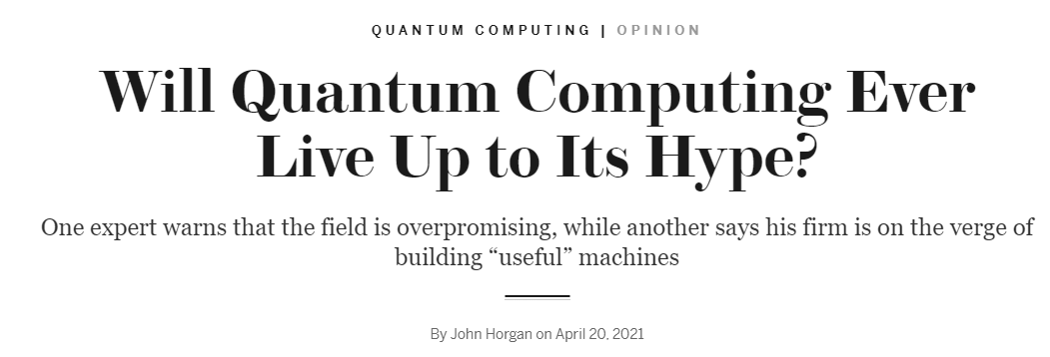
What is the state of quantum computing?
Wired
Forbes
Scientific
American
Why care ?
STORE NOW, DECRYPT LATER
Cryptography Based on Learning With Errors
Φλωριάς Παπαδόπουλος
Notes:
Σχετικά με το πόσο κοντά είμαστε στην κατασκευή ενός κβαντικού υπολογιστή αρκετά δυνατού ώστε να τρέχει τους κβαντικούς αλγορίθμους που αναφέραμε
στην ερευνητική κοινότητα κυριαρχεί η ιδέα ότι είμαστε κοντά αλλά και μακριά ταυτόχρονα, όπως μπορείτε να δείτε και σε αυτά τα άρθρα τα οποία έχουν γραφτεί τα τελευταία 2-3 χρόνια.
Αυτό σημαίνει ότι η πλειοψηφία των επιστημόνων πιστεύει ότι, αν και γίνονται τεράστια βήματα καθημερινά, ακόμα δεν έχουν ξεπεραστεί διάφορα σημαντικά προβλήματα και άρα ίσως είμαστε ακόμη μερικές δεκαετίες μακριά από τον στόχο μας.
Οπότε, γιατί μας ενδιαφέρει από τώρα αυτό το θέμα και ασχολούμαστε???
Λόγω της τεχνικής STORE NOW, DECRYPT LATER, σύμφωνα με την οποία μπορεί κάποιος να υποκλέψει και να αποθηκεύσει μηνύματα σημαντικής αξίας σήμερα, ώστε να τα αποκρυπτογραφήσει με την βοήθεια ενός μεγάλου κβαντικού υπολογιστή στο μέλλον.

Slide 11
Lattices and
Lattice Algorithms
b₁
b₂

Slide 12
Basics of Lattices II
lattice rank
$$L=\left\{x_{1}b_{1}+x_{2}b_{2} | x_{1},x_{2}∈ℤ\right\}$$
A subset $L⊂ℝ^{m}$ is called a lattice, if there is a linearly independent set of vectors $\left\{b_{1},…,b_{n}\right\}$ in $ℝ^{m} (m≥n)$ s.t.:
$$L=L\left(b_{1},…,b_{n}\right)=\left\{\sum_{j=1}^{n}{x_{j}b_{j}} | x_{j}∈ℤ\right\}$$
lattice basis
lattice dimension
$$L\left(B\right)=\left\{Bx | x∈ ℤ^{n}\right\}=Bℤ^{n}$$
b₁
If $n=m→$ $L$ is a full-rank lattice.
If $n>2 →$ infinitely many choices for a basis.
$B$ ↔ $B′$ easily.
b₂
Cryptography Based on Learning With Errors
Florias Papadopoulos

Slide 13
$$L\left(B\right)=\left\{Bx | x∈ ℤ^{n}\right\}$$
An example
of a 3D lattice
$$B=\left[\begin{matrix}1 & 1 & 3 \\ 2 & 2 & 1 \\ 3 & 1 & 2\end{matrix}\right]$$
$$b_{1}$$
$$b_{2}$$
$$b_{3}$$
Cryptography Based on Learning With Errors
Florias Papadopoulos

Slide 14
$L → n$-dimensional lattice
Basics of Lattices II
$$P+b1+b2$$
Fundamental Parallelepiped
Let $B$ be an $n×n$ basis matrix of $L$.
$$P\left(B\right)=\left\{Bx | x∈{\left[0,\right.\left.1\right)}^{n}\right\}$$
$$P+b2$$
$$P+b1$$
Determinant or volume of $L$
It is the volume of P(B), $\det\left(L\right)=\left|det⁡(B)\right|$
b₁
$$P$$
Hadamard’s Inequality
Let $\left\{b_{1},…,b_{n}\right\}$ be a basis of $L$. Then, $\det\left(L\right)≤\left\|b_{1}\right\|∙∙∙\left\|b_{n}\right\|$, with equality if-f $b_{1},…,b_{n}$ are pairwise orthogonal.
b₂
$L$
G-S
$$\left\{b_{1}^{∗},…,b_{n}^{∗} \right\}$$
$$\det\left(L\right)=\left\|b_{1}^{∗}\right\|∙∙∙\left\|b_{n}^{∗}\right\|\text{.}$$
$$L\left(B\right)=\left\{Bx | x∈ ℤ^{n}\right\}$$
$=\left\{a_{1}b_{1}+a_{2}b_{2 } | a_{1},a_{2}∈ℤ\right\}$
Cryptography Based on Learning With Errors
Florias Papadopoulos

Slide 15
$L → n$-dimensional lattice
Basics of Lattices III
Successive minima
For $1≤i≤n$, $λ_{i}$ is the smallest possible positive number s.t. there exist linearly independent vectors $u_{1},…,u_{i}∈L$ satisfying $\left\|u_{i}\right\|≤λ_{i}$, for $1≤j≤i$.
$u_{2}$
$λ_{2}$
$u_{1}$
$λ_{1}$
$0<λ_{1}≤λ_{2}≤…≤λ_{n}$
$λ_{1}=\inf_{x∈L/\{0\}}\{‖x‖\}$
$$λ_{1}(L)$$
$L$
Cryptography Based on Learning With Errors
Florias Papadopoulos
Notes:
there is at least one vector z ∈ L such that ||z|| = λ1 (proof in
Theorem 14.3.1 of [Gal18]) and that λ1, which is also called first successive minima, is independent
of the choice of basis for the lattice L. Thus, we also denote λ1 as λ1(L), underscoring its
specificity to each lattice L.

Slide 16
$L → n$-dimensional lattice
$B→$ some basis matrix of $L$
$γ →$Fixed constant $>1$
Hard Lattice Problems I
Shortest Vector Problem (SVP)
Given $B$, find nonzero $u∈$ s.t. $\left\|u\right\|=λ_{1}(L)$.
$b_{1}$
$b_{2}$
Decisional Shortest Vector Problem (GapSVP)
Given $B$ and a real number $d>0$.
Determine whether $λ_{1}\left(L\right)≤d$ or $λ_{1}\left(L\right)>d$
Approximate Shortest Vector Problem (SVP_{γ})
Given $B$, find nonzero $u∈L$ s.t. $\left\|u\right\|≤γλ_{1}(L)$.
$$u$$
$λ_{1}$
Approximate Decisional Shortest Vector Problem (GapSVP_{γ})
Given $B$ and a real number $d>0$,
Determine whether $λ_{1}\left(L\right)≤d$ or $λ_{1}\left(L\right)>γd$
${γλ}_{1}$
$L$
Cryptography Based on Learning With Errors
Florias Papadopoulos

Slide 17
$L → n$-dimensional lattice
$B→$ some basis matrix of $L$
$γ →$Fixed constant $>1$
Hard Lattice Problems II
Closest Vector Problem (CVP)
Given $B$ and a point $t∈ℝ^{n}$, compute $u∈L$ s.t. $\left\|u−t\right\|$ is minimal.
$b_{1}$
$b_{2}$
Decisional Closest Vector Problem (GapCVP)
Given $B$, a point $t∈ℝ^{n}$ and a real number $d>0.$
Determine whether there exists $u∈L$ s.t. $\left\|u−t\right\|≤d$ or not.
$$u$$
$t$
Approximate Closest Vector Problem (CVP_{γ})
Given $B$ and a point $t∈ℝ^{n}$,
compute $u∈L$ s.t. $\left\|u−t\right\|≤γ\left\|y−t\right\|, ∀y∈L$.
Approximate Decisional Shortest Vector Problem (GapCVP_{γ})
Given $B$, a point $t∈ℝ^{n}$ and a real number $d>0$.
Determine whether $dist(t,L)≤d$ or $>γd$.
$L$
Cryptography Based on Learning With Errors
Florias Papadopoulos

Slide 18
$L → n$-dimensional lattice
$B→$ some basis matrix of $L$
$γ →$Fixed constant $>1$
Hard Lattice Problems III
Approximate Shortest Independent Vectors Problem (SIVP_{γ})
Given $B$, output a set $S=\{u_{1},…,u_{n}\}⊂L$ of $n$ linearly independent vectors s.t. $\left\|u_{i}\right\|≤γλ_{n}\left(L\right), ∀i$.
$b_{1}$
$b_{2}$
$$u$$
$t$
${αλ}_{1}$
$λ_{1}$
Bounded Distance Decoding Problem (BDD$α$)
Fix $a∈(0,1)$. Given $B$ and a vector $t∈ℝ^{n}$ s.t.
$∃ u∈L$ with $\left\|u−t\right\|≤{αλ}_{1}$, compute $u$.
$L$
Cryptography Based on Learning With Errors
Florias Papadopoulos

Slide 19
1st Approach - Bounds and Heuristics
$$γ \text{≲} \frac{n}{πe}$$
Minkowski’s Theorem
There is a constant $γ$ so that for all lattices $L$ of dimension $n$:
$∃$ nonzero $u∈L$ s.t. $\left\|u\right\|≤γ^{1/2}{det⁡(L)}^{1/n}$.
$∃$ basis $u_{1},…,u_{n}$ for $L$ s.t. $\left\|u_{1}\right\|∙∙∙\left\|u_{n}\right\|≤γ^{n/2}det⁡(L)$.
Upper bounds for SVP, SIVP
Gaussian Heuristic (GH)
Let $L(B)⊂ℝ^{n}$ be a random lattice, with $n$ sufficiently large.
SVP: We expect that the smallest nonzero vector in $L$ satisfies
$$λ_{1}\left(L\right)=\min_{u∈L/\{0\}}\left\|u\right\|≈\sqrt{\frac{n}{2πe}}{det⁡(L)}^{1/n}$$
CVP: Let $t∈ℝ^{n}$ be a random target point. Then, we expect
$$\min_{u∈L}\left\|u−t\right\|≈\sqrt{\frac{n}{2πe}}{det⁡(L)}^{1/n}$$
Cryptography Based on Learning With Errors
Florias Papadopoulos

Slide 20
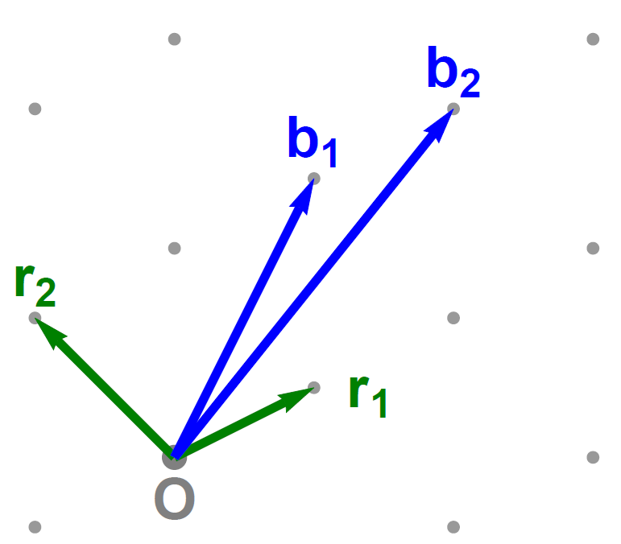
1st Approach - Good and Bad Bases
Hadamard’s Inequality
Let $\left\{b_{1},…,b_{n}\right\}$ be a basis of $L$. Then, $\det\left(L\right)≤\left\|b_{1}\right\|∙∙∙\left\|b_{n}\right\|$, with equality if-f $b_{1},…,b_{n}$ are pairwise orthogonal.
Looking for small vectors
$$⇒$$
Lattice Bases
“Good” Basis
“Bad” Basis
Lagrange Algorithm
Lattice Basis Reduction
LLL Algorithm
$$\left\|b_{1}\right\|≤2^{{(n−1)}/2}λ_{1}$$
BKZ Algorithm
$$⇒$$
LLL efficiently solves SVP_{γ} , for $γ=2^{O(n)}$
Cryptography Based on Learning With Errors
Florias Papadopoulos
Notes:
there is at least one vector z ∈ L such that ||z|| = λ1 (proof in
Theorem 14.3.1 of [Gal18]) and that λ1, which is also called first successive minima, is independent
of the choice of basis for the lattice L. Thus, we also denote λ1 as λ1(L), underscoring its
specificity to each lattice L.

Slide 21
Complexity of lattice problems
SVP
Cryptography Based on Learning With Errors
Florias Papadopoulos
Notes:
When you randomly sample keys, often you are (implicitly) randomly sampling an instance of some underlying problem, so "breaking" things becomes an average-case problem. If there exists an efficient algorithm solving Q, then there is also one for P

Slide 22
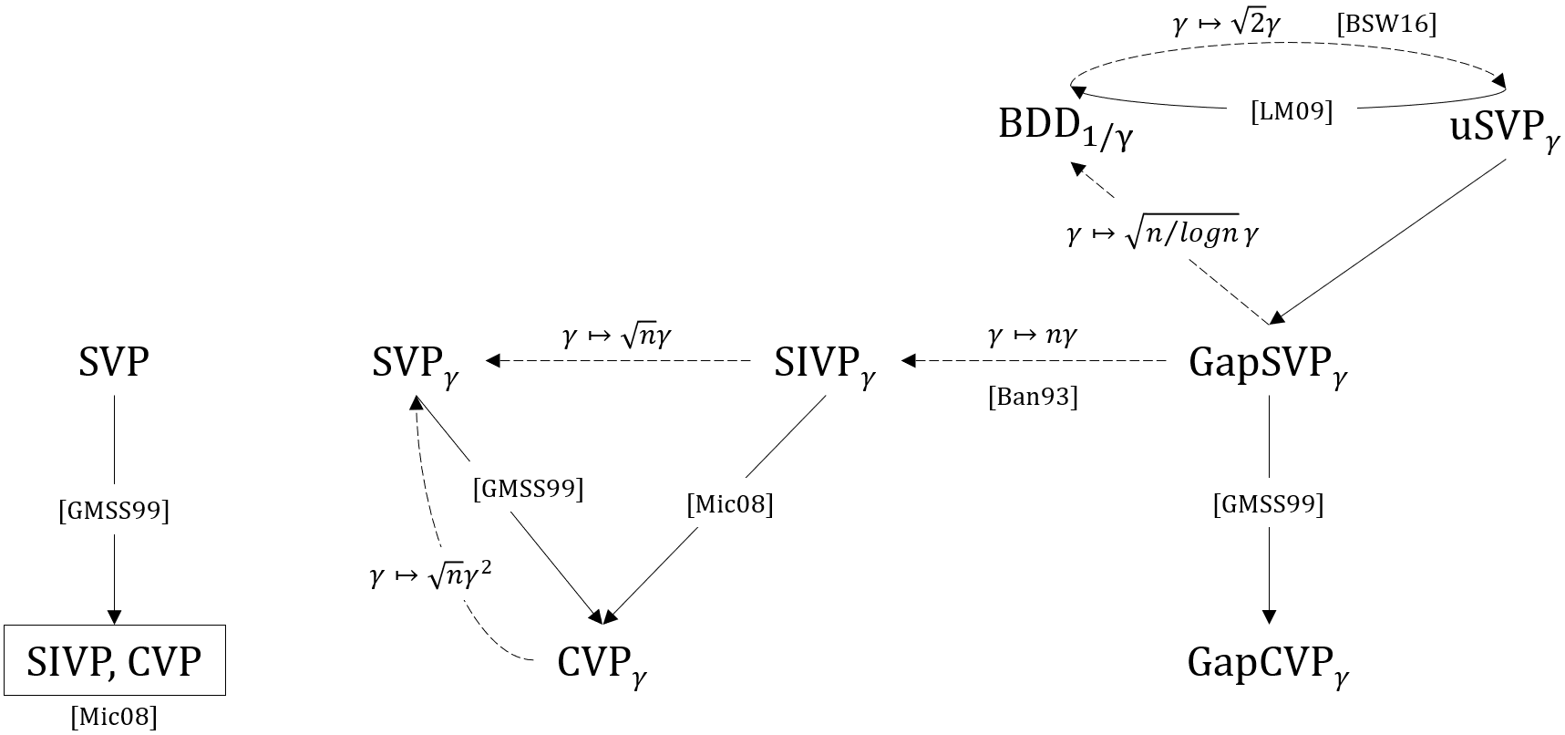
Complexity of lattice problems
Reductions
$$P→Q$$
$$⇔$$
$P$ reduces to $Q$
$$⇔$$
$Q$ is at least as hard as $P$
Cryptography Based on Learning With Errors
Florias Papadopoulos
Notes:
When you randomly sample keys, often you are (implicitly) randomly sampling an instance of some underlying problem, so "breaking" things becomes an average-case problem. If there exists an efficient algorithm solving Q, then there is also one for P

Slide 23
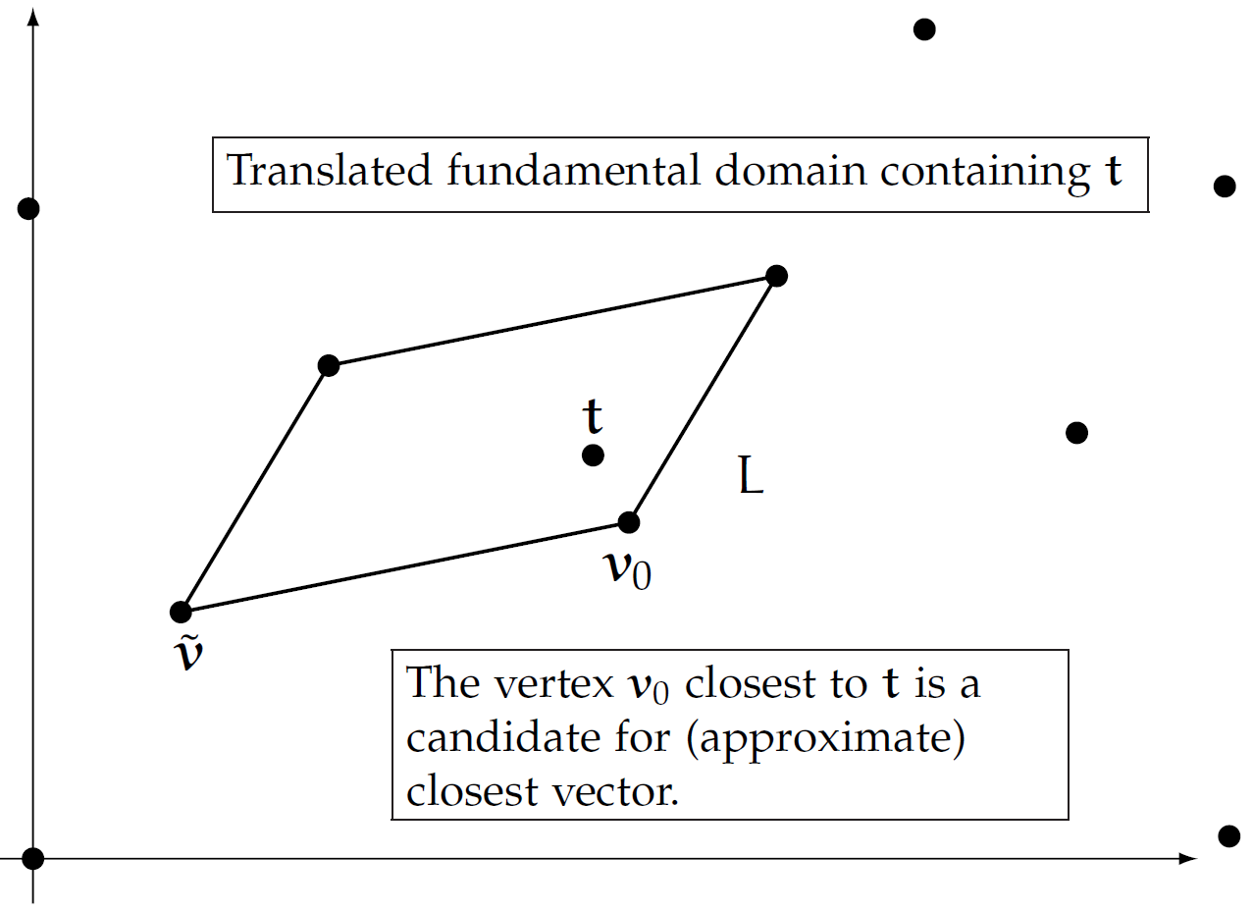
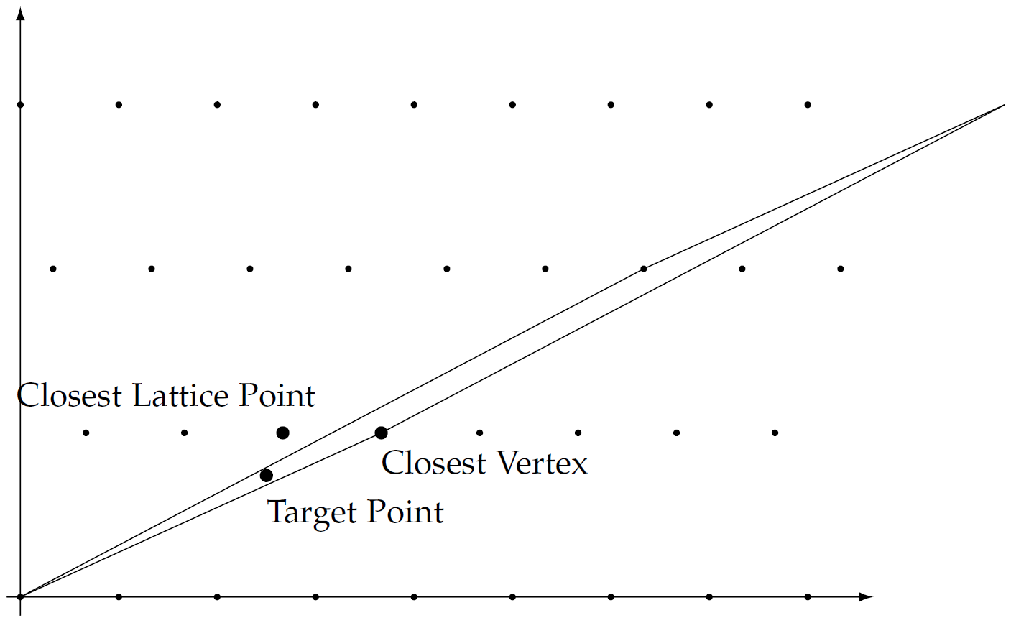
$L → n$-dimensional lattice
Solving CVP: Babai’s Rounding
Closest Vector Problem (CVP)
Given a basis $\{b_{1},…,b_{n}\}$ and a point $t∈ℝ^{n}$, compute $u∈L$ s.t. $\left\|u−t\right\|$ is minimal.
$$t=\sum_{i=1}^{n}{t_{i}}b_{i}$$
$$u=\sum_{i=1}^{n}{\left\lfloor t_{i}\right\rfloor }b_{i}$$
Cryptography Based on Learning With Errors
Florias Papadopoulos

Slide 24
Solving SVP
Lattice Algorithms
Exact \ Near exact Algorithms
Sieving
Heuristic Solution
Perturbation Solution
“Sieving by averages”
Enumeration
Kannon’s Method
Approximation Algorithms
LLL
BKZ
Variant of [GN08]
Dual BKZ [MW16]
Pohst’s Method
Enumeration with pruning
Micciancio-Voulgaris Algorithm [MV13]
Cryptography Based on Learning With Errors
Florias Papadopoulos
Notes:
Exact/Near exact algorithms (like [AKS01; Kan87]), that provably output a shortest vector.
- Approximation algorithms (like [LLL82; Sch87; Gam+06; GN08a]), which output a nonzero
lattice vector whose norm is provably not much bigger than that of a shortest vector enumeration -> super-exponential time complexity & polynomial space complexity enumeration -> exponential time complexity & exponential space complexity

Slide 25
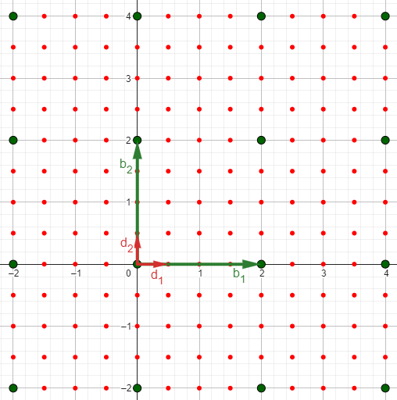
Basics of Lattices IV
Dual of $2ℤ^{2}$ is $\frac{1}{2}ℤ^{2}$
Dual Lattice
Let $L⊆ℝ^{m}$ be a lattice.
Let $V⊆ℝ^{m}$ the $ℝ$-vector space spanned by the vectors in $L$.
$L^{∗}=\{y∈V$| $\left\langle x,y\right\rangle ∈ℤ, ∀x∈L\}$
Dual of $ℤ^{n}$ is $ℤ^{n}$.
Dual of $cL$ is $\frac{1}{c}L^{∗}$, for $c>0$ and $L$ lattice.
Proposition
(i) $L→$ basis $B ⇒$ $L^{∗}→$ basis $D=B{(BB)}^{−1}$.
(ii) $\det\left(L^{∗}\right)=1/{det⁡(L)}$.
Cryptography Based on Learning With Errors
Florias Papadopoulos

Slide 26
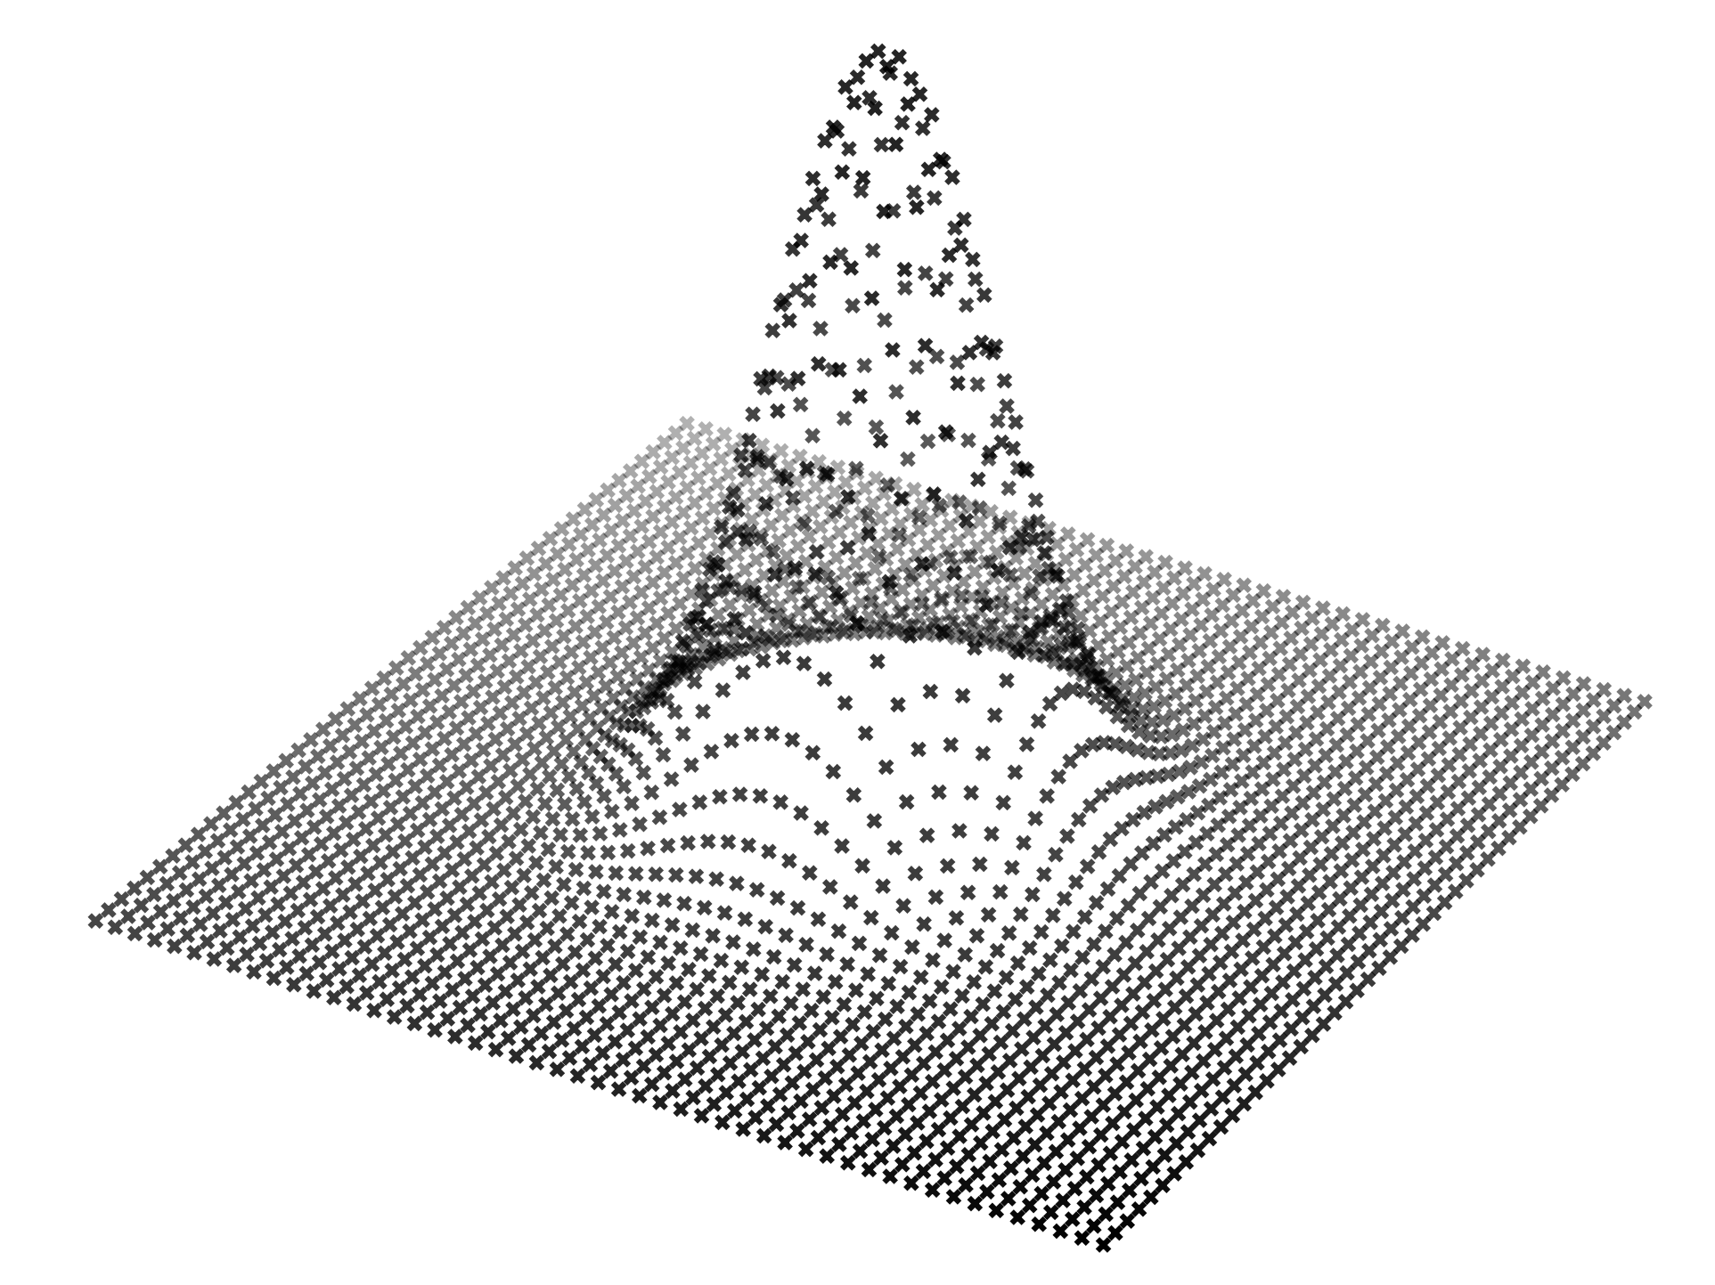
Learning
With Errors

Slide 27
$q→$positive integer
Lattices used in Cryptography
𝑞-ary Lattice
A lattice $L$ of dimension $m$ satisfying $qℤ^{m}⊆L⊆$ $ℤ^{m}$.
Parity Check Lattice
Let $A∈ℤ_{q}^{n×m}$ be a matrix with coefficients in $ℤ_{q}$.
$$L_{q}^{⊥}\left(A\right)=\left\{x∈ℤ^{m} \right| Ax≡0 (mod q)\}$$
crypto
Hard Problems over their random instances
Row-generated Lattice
Let $A∈ℤ_{q}^{n×m}$ be a matrix with coefficients in $ℤ_{q}$.
$L_{q}\left(A\right)=\left\{z∈ℤ^{m} \right| z{=A}^{T}s mod q,$ for $s∈ℤ^{n}\}$
Hard Problems over any lattice
Worst-case to average-case reduction
Cryptography Based on Learning With Errors
Florias Papadopoulos

Slide 28
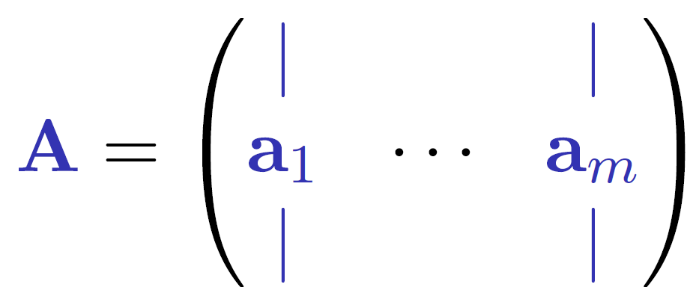
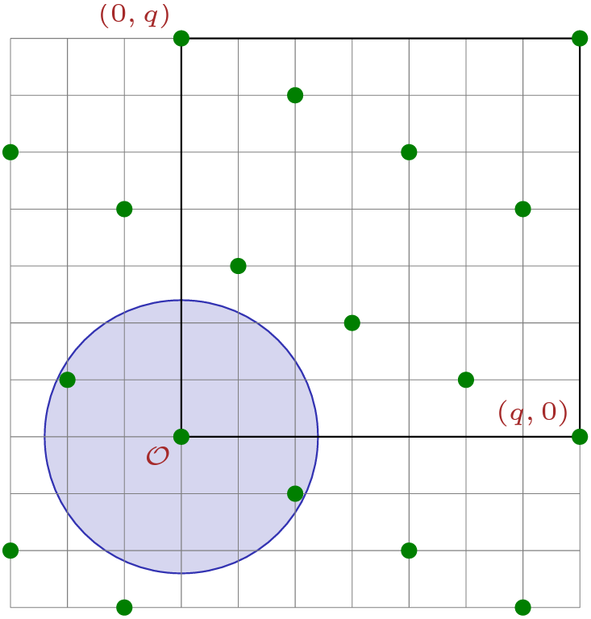
$n,q→$positive integer
$β →$ positive real
Shortest Integer Solution (SIS)
$$A∈ℤ_{q}^{n×m} chosen uniformly at random$$
SIS problem
Find a nonzero vector $z∈ℤ^{m}$ s.t. $\left\|z\right\|≤β$ & $Az=0 mod q.$
Parity Check Lattice
Let $A∈ℤ_{q}^{n×m}$ be a matrix with coefficients in $ℤ_{q}$.
$$L_{q}^{⊥}\left(A\right)=\left\{x∈ℤ^{m} \right| Ax≡0 (mod q)\}$$
SIS ↔ Average-Case SVP
Cryptography Based on Learning With Errors
Florias Papadopoulos

Slide 29
Hardness of SIS
GapSVP_{γ}
Crypto
One-Way Functions,
Collision-Resistant, Hash Functions,…
SIS
SIVP_{γ}
Cryptography Based on Learning With Errors
Florias Papadopoulos

Slide 30
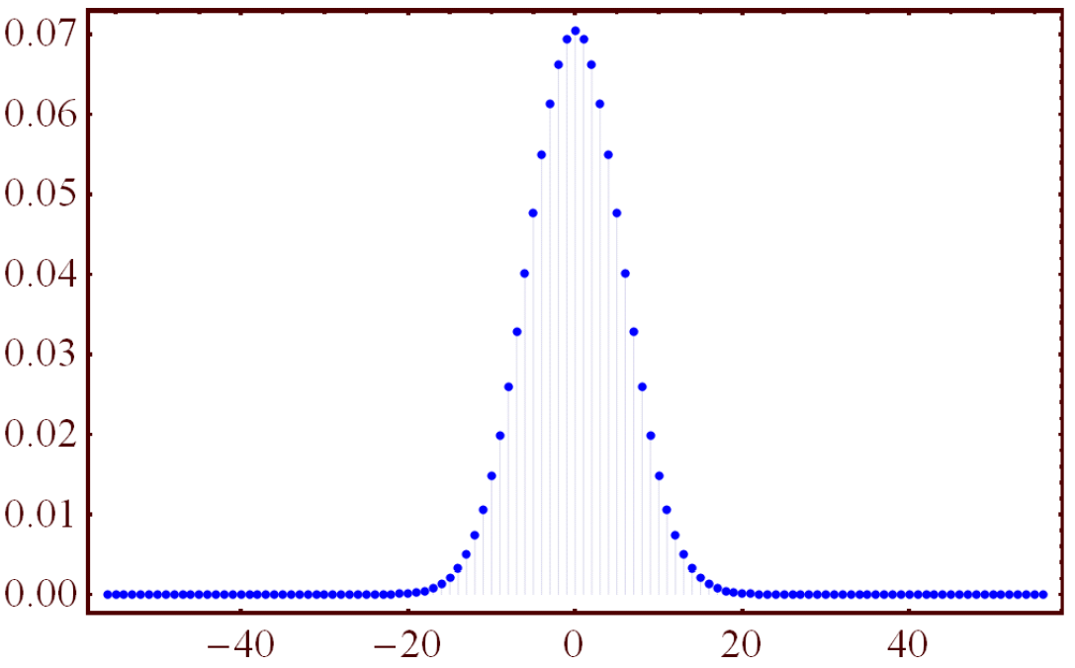
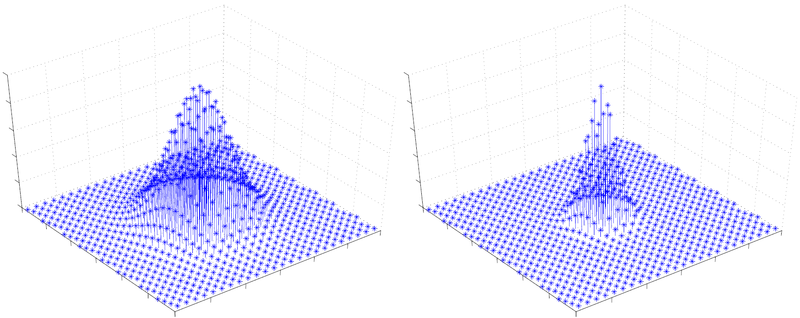
Modulus $q>2$
“Error rate” $a≪1$
Learning With Errors (LWE)
$$A∈ℤ_{q}^{n×m} chosen uniformly at random$$
Search LWE
Find $s∈ℤ_{q}^{n}$, given “noisy random inner products” $→A∈ℤ_{q}^{n×m}$, $b^{T}=s^{T}A+e^{T}$,
where the errors $e_{i}$ are chosen from $χ=$ Discrete Gaussian, param $aq>\sqrt{n}.$
Decision LWE
Distinguish $\left(a_{i},b_{i}\right)$ from uniform $\left(a_{i},b_{i}\right)$ pairs.
Hermite normal form of LWE
LWE is not easier if the secret is drawn from the error distribution $χ$.
Cryptography Based on Learning With Errors
Florias Papadopoulos
Notes:
Gaussian is normal distribution (i) centered at 0, (ii) standard deviation s/sqrt{2π} Micciancio Regev 2004 -> Uniformity and Gaussian

Slide 31
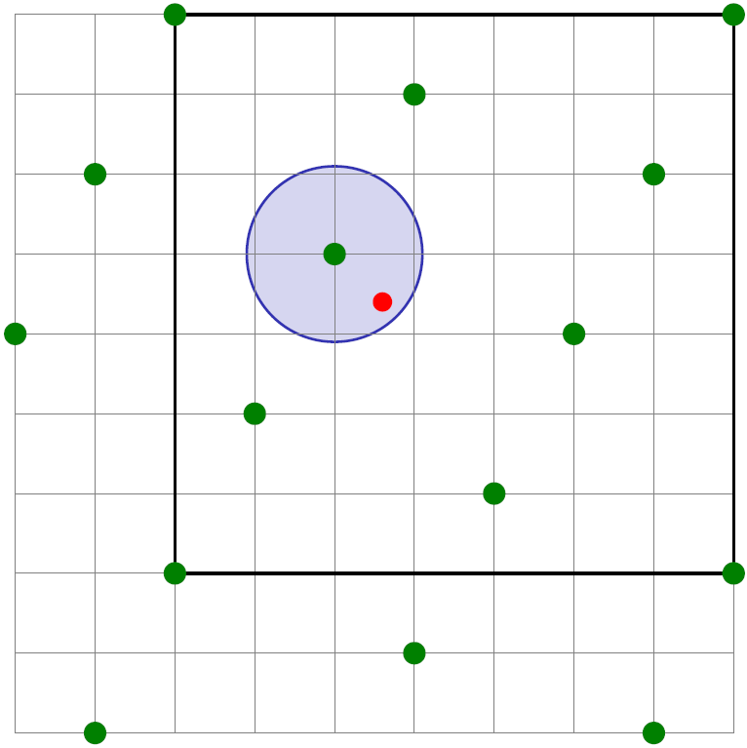
Modulus $q>2$
“Error rate” $a≪1$
Learning With Errors (LWE)
$$A∈ℤ_{q}^{n×m} chosen uniformly at random$$
Search LWE
Find $s∈ℤ_{q}^{n}$, given “noisy random inner products” $→A∈ℤ_{q}^{n×m}$, $b^{T}=s^{T}A+e^{T}$,
where the errors $e_{i}$ are chosen from $χ=$ Discrete Gaussian, param $aq>\sqrt{n}.$
Row-generated Lattice
Let $A∈ℤ_{q}^{n×m}$ be a matrix with coefficients in $ℤ_{q}$.
$L_{q}\left(A\right)=\left\{z∈ℤ^{m} \right| z^{T}{=A}^{T}s mod q,$ for $s∈ℤ^{n}\}$
LWE ↔ Average-Case BDD
Cryptography Based on Learning With Errors
Florias Papadopoulos

Slide 32
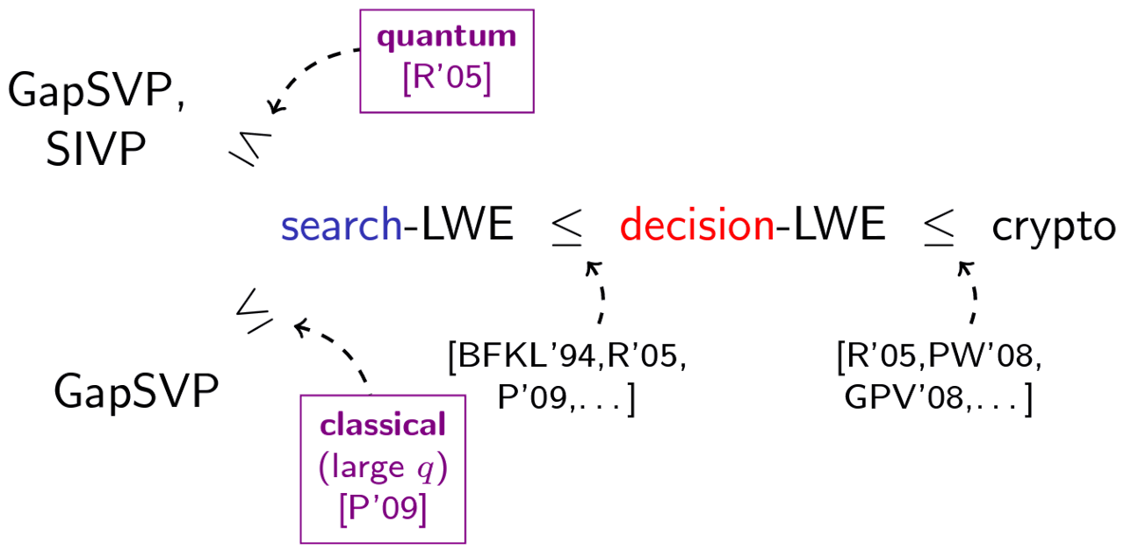
Hardness of LWE
Cryptography Based on Learning With Errors
Florias Papadopoulos

Slide 33
Regev’s LWE Cryptosystem
$$A←ℤ_{q}^{n×m}$$
$$s←ℤ_{q}^{n}$$
x$←{\{0,1\}}^{m}$
$$b^{T}=s^{T}A+e^{T}$$
public key $→(A,b^{T})$
$$u=Ax$$
Ciphertext “preamble”
$$u^{′}− s^{T}u ≈$$
$$bit∙q/2$$
$$u^{′}=b^{T}x+bit∙q/2$$
“payload”
$$\left(A,b^{T}\right), (u,u^{′})$$
LWE
LHL
$$m≥n log q$$
$$\left(A,b^{T}\right), (u,u^{′})$$
Cryptography Based on Learning With Errors
Florias Papadopoulos

Slide 34
Compact Cryptosystem
$$A←ℤ_{q}^{n×n}$$
$$s←χ^{n}$$
r$←χ^{n}$
$$b^{T}=s^{T}A+e_{1}^{T}$$
public key $→(A,b^{T})$
Practical limitations of LWE
public data size, speed
$$u=Ar+e_{2}$$
Ciphertext “preamble”
$$u^{′}− s^{T}u ≈$$
$$bit∙q/2$$
$$u^{′}=b^{T}r+e_{3}+bit∙q/2$$
Solution
Use structured lattices
“payload”
$$(A,b,u,u^{′})$$
LWE (HNF) x2
$$(A,b,u,u^{′})$$
Cryptography Based on Learning With Errors
Florias Papadopoulos

Slide 35
Ring-LWE
Change $ℤ_{q}^{n}$ to $R_{q}≔{ℤq[X]}/{\left\langle \left.X^{n}+\left.1\right\rangle \right.\right.}$, for $n$ a power of 2.
Elements of $R_{q}$are $deg<n$ polynomials with $mod q$ coefficients.
Operations in $R_{q}$ are very efficient using FFT-like algorithms.
Search Ring-LWE
Find secret ring element $s∈R_{q}$, given $m$ independent samples
$a_{1}←R_{q}$, ${ b}_{1}=s∙a_{1}+e_{1}∈R_{q}$
$a_{2}←R_{q}$, ${ b}_{2}=s∙a_{2}+e_{2}∈R_{q}$
⋮
⋮
where $e_{i}←χ$, with $χ=$ Discretized Gaussian in the canonical embedding of $R≔{ℤ\left[X\right]}/{\left\langle \left.X^{n}+\left.1\right\rangle \right.\right.}$.
Decision Ring-LWE
Distinguish $(a_{i},b_{i})$ from uniform $(a_{i},b_{i})∈R_{q}×R_{q}$.
It is a homomorphism into $ℂ$, with which we define geometry on the ring.
Cryptography Based on Learning With Errors
Florias Papadopoulos

Slide 36
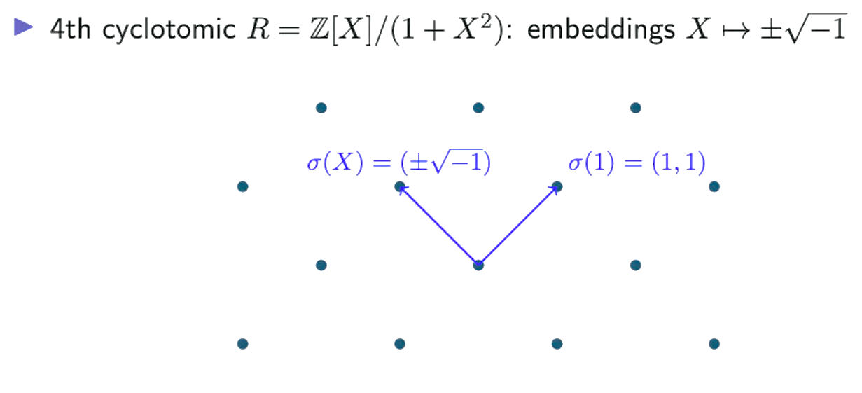
Ring-LWE
Ideal Lattice
A lattice corresponding to an ideal $I$ in a ring $R$, under some fixed choice of geometric embedding.
Multiplicative closure of ideals $→$ Extra structure
Problems in Ideal Lattices
Viewing ideals as lattices allows us to extend lattice problems to ideals giving us the corresponding problems restricted to ideal lattices.
Ideal-SVP$γ$
Ideal-SΙVP$γ$
Ideal-GapSVP$γ$
Cryptography Based on Learning With Errors
Florias Papadopoulos
Notes:
it can be useful (e.g. for efficiency) or dangerous, if it can be utilised by adversaries to solve a hard problem in ideal lattices.

Slide 37
Hardness of Ring-LWE
Crypto
Compact RLWE Cryptosystem
Decisional RLWE
Search RLWE
Quantum
reduction
Ideal-SVP_{γ}
Cryptography Based on Learning With Errors
Florias Papadopoulos

Slide 38
Module-LWE
Module
An algebraic structure generalizing rings and vector spaces.
Module lattices
Correspond to finitely generated modules over the ring of integers of a number field
Generalize both arbitrary lattices and ideal lattices.
Module-LWE
- For a secret, it uses a vector $s∈R_{q}^{k}$ of ring elements.
- Its samples are of the form $(a,b)∈R_{q}^{k}×R_{q}$,
where either $b=\left\langle \left.s,\left.a\right\rangle \right.\right.+e mod q$, for $e←χ$
or $b∈R_{q}$ is uniformly random.
$$R=ℤ$$
$k$-dimensional LWE problem
$$k=1$$
$$RLWE$$
Decisional MLWE
Search MLWE
Quantum
reduction
Module-SVP_{γ}
Crypto
Cryptography Based on Learning With Errors
Florias Papadopoulos

Slide 39
CRYSTALS-Kyber

Slide 40
*FO = Fujisaki-Okamoto
Creating Kyber
Compact MLWE Cryptosystem
NTT in the ring $Rq{=ℤq[X]}/{\left\langle \left.X^{n}+\left.1\right\rangle \right.\right.}$
IND-CPA PKE
IND-CCA2 KEM
Kyber.CPAPKE
Kyber.CCAKEM
Compression/Decompression
FO Transform
$χ=$ Centered Binomial Distribution
Cryptography Based on Learning With Errors
Florias Papadopoulos

Slide 41
Kyber’s Performance I
Faster than previous
Bigger keys than previous
Cryptography Based on Learning With Errors
Florias Papadopoulos

Slide 42
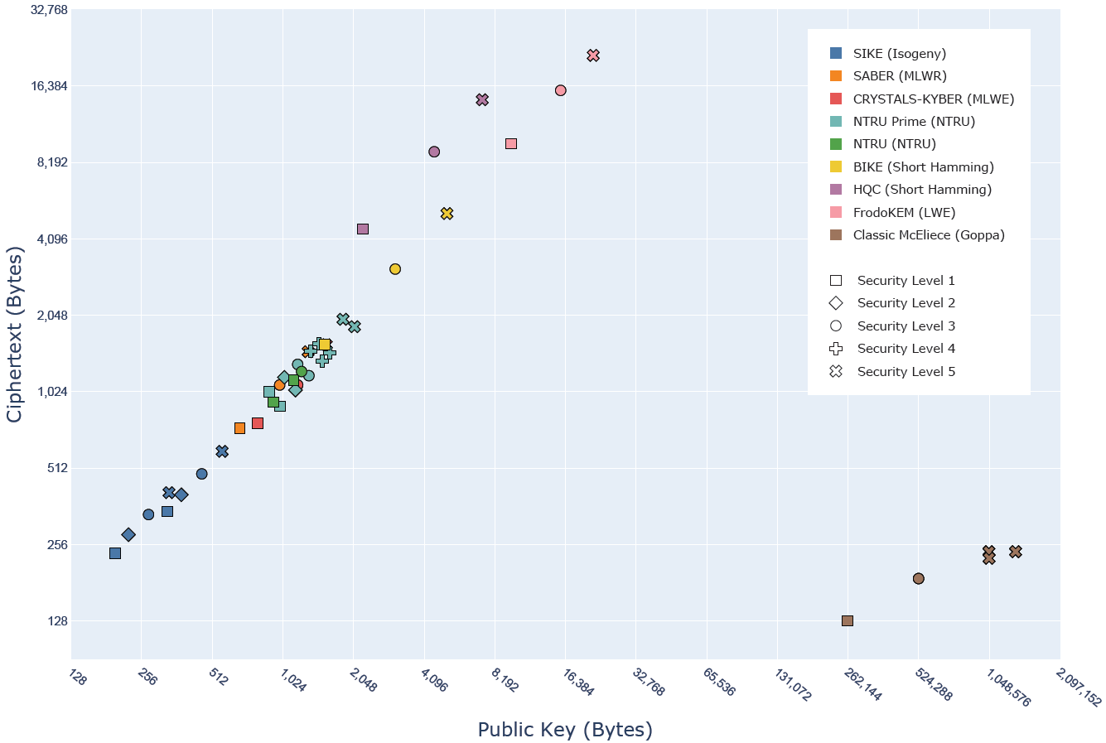
Kyber’s Performance II
Cryptography Based on Learning With Errors
Florias Papadopoulos

Slide 43
Kyber’s Security
Decisional MLWE
Search MLWE
Quantum
reduction
Module-SVP_{γ}
Kyber
Analysis
(part of)
Extra algebraic structure of MLWE
primal attack
(BKZ algorithm with sieving or enumeration as SVP oracle)
Attacking the underlying LWE problem
dual attack
Kyber512
Kyber768
Kyber1024
Cryptography Based on Learning With Errors
Florias Papadopoulos

Slide 44
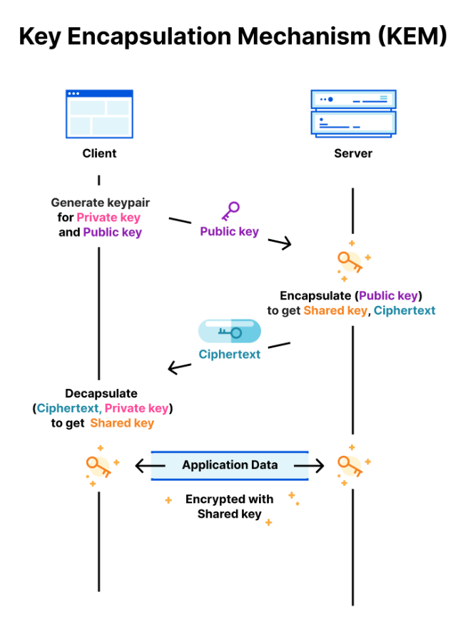
Real world application: X25519Kyber768
X25519Kyber728 is a hybrid post-quantum key exchange protocol designed for use in TLS 1.3.
Security is achieved if either component is secure.
Actively used in Google Chrome (from Chrome 116 onwards) and can be enabled in "chrome://flags:
Cryptography Based on Learning With Errors
Florias Papadopoulos
Notes:
Transport Layer Security (TLS)
A network protocol that establishes an encrypted connection to an authenticated peer over an untrusted network.

