Slide 1
ΑΡΙΣΤΟΤΕΛΕΙΟ ΠΑΝΕΠΙΣΤΗΜΙΟ ΘΕΣΣΑΛΟΝΙΚΗΣ
ΣΧΟΛΗ ΘΕΤΙΚΩΝ ΕΠΙΣΤΗΜΩΝ
ΤΜΗΜΑ ΜΑΘΗΜΑΤΙΚΩΝ
Numerical methods for solving systems of
chaotic first-order differential equations
ΦΛΩΡΙΑΣ ΠΑΠΑΔΟΠΟΥΛΟΣ
Notes:
Καλησπέρα σε όλους,
Ονομάζομαι Φλωριάς Παπαδόπουλος, είμαι απόφοιτος του τμήματος Μαθηματικών του ΑΠΘ και σήμερα θα σας μιλήσω για την Κρυπτογραφία στη Μετακβαντική Εποχή,
ένα θέμα που επιμελήθηκα με την συμβολή του κ. Παύλου Μαραντίδη, μεταδιδακτορικού ερευνητή του τμήματος Μαθηματικών του ΑΠΘ.
Οπότε, χωρίς επιπλέον καθυστέρηση *Ν*

Slide 2
$$σ=10ss.$$
$$ρ=28,,s$$
$$β=2.667$$
Chaotic Lorenz system
$$\left\{\begin{aligned}x^{′}\left(t\right)=σ\left(y\left(t\right)−x\left(t\right)\right)wwww \\ y^{′}\left(t\right)=x(t)\left(ρ−z\left(t\right)\right)−y(t) \\ z^{′}\left(t\right)=x\left(t\right)y(t)−βz\left(t\right)qww\end{aligned}\right.$$
$a =10$aa,
$$b =2.667$$
$$c =46a,,$$
$$d =12,,, ,$$
$$e =10….$$
$$\left\{\begin{aligned}{x_{1}}^{′}\left(t\right)=f_{1}(x_{1}\left(t\right),…,x_{n}\left(t\right))www \\ ⋮ \\ {x_{n}}^{′}\left(t\right)=f_{n}(x_{1}\left(t\right),…,x_{n}\left(t\right))qww\end{aligned}\right.$$
Hyperchaotic 4d Lorenz system
$$\left\{\begin{aligned}x^{′}\left(t\right)=a\left(y\left(t\right)−x\left(t\right)\right)wwwwwwwwww \\ y^{′}\left(t\right)=cx\left(t\right)−x\left(t\right)z\left(t\right)−y\left(t\right)+ew\left(t\right) \\ z^{′}\left(t\right)={x(t)}^{4}+{y(t)}^{4}−bz\left(t\right)mmmmm. \\ w^{′}\left(t\right)=−dy\left(t\right),,,,,wwwwwwwwwwww\end{aligned}\right.$$
Numerical methods for solving systems of chaotic first-order differential equations
Φλωριάς Παπαδόπουλος

Slide 3
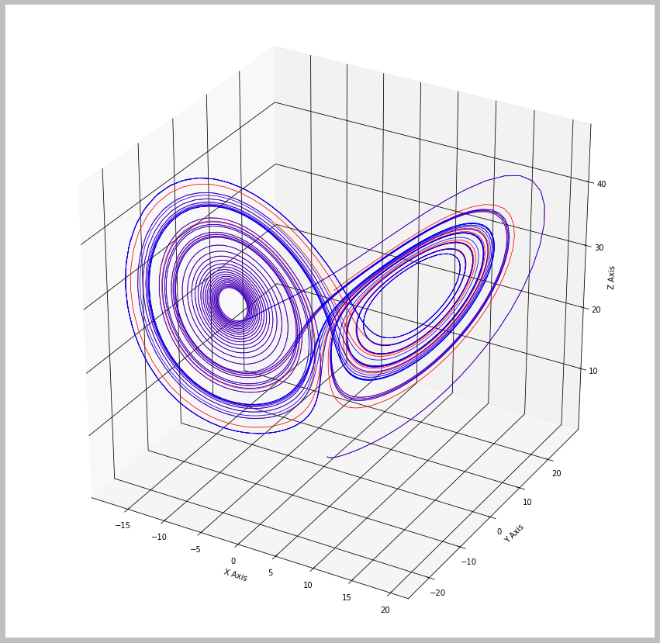
What does chaotic mean?
“Chaos is aperiodic long-term behavior in a deterministic system that exhibits sensitive dependence on initial conditions”
Aperiodic long-term behavior
Deterministic
Sensitive dependence on initial conditions
Numerical methods for solving systems of chaotic first-order differential equations
Φλωριάς Παπαδόπουλος

Slide 4
How to solve the generalized system?
Numerical Methods
Explicit Methods
Forward Euler
4th Runge-Kutta
Implicit Methods
Raphson-Newton
Backward Euler
$$X_{k+1}=X_{k}+h f(X_{k}^{T})$$
$$X_{k+1}=X_{k}+h/6[K_{1}+2K_{2}+2K_{3}+K_{4}]$$
$$X_{k+1}=X_{k}+h f(X_{k+1}^{T})$$
Numerical methods for solving systems of chaotic first-order differential equations
Φλωριάς Παπαδόπουλος

Slide 5
Approaching the problem with Python
$$\left\{\begin{aligned}{x_{1}}^{′}\left(t\right)=f_{1}(x_{1}\left(t\right),…,x_{n}\left(t\right))www \\ ⋮ \\ {x_{n}}^{′}\left(t\right)=f_{n}(x_{1}\left(t\right),…,x_{n}\left(t\right))qww\end{aligned}\right.$$
or
$${ X}^{′}=f$$
Creation of $\left(x_{1},…,x_{n}\right) using SymPy.$
Definition of $f_{1},…,f_{n} using SymPy.$
Computation of $f using SymPy$.
Creation of a function for the repeating algorithm.
Use of the previous function in each iteration of the discretization.
Output of the solutions $\left(x_{1},…,x_{n}\right)$ for each iteration.
+ One extra step in backward Euler is the use of the Newton method.
$$X_{k+1}=X_{k}+h f(X_{k}^{T})$$
Numerical methods for solving systems of chaotic first-order differential equations
Φλωριάς Παπαδόπουλος

Slide 6
Lorenz systems

Slide 7
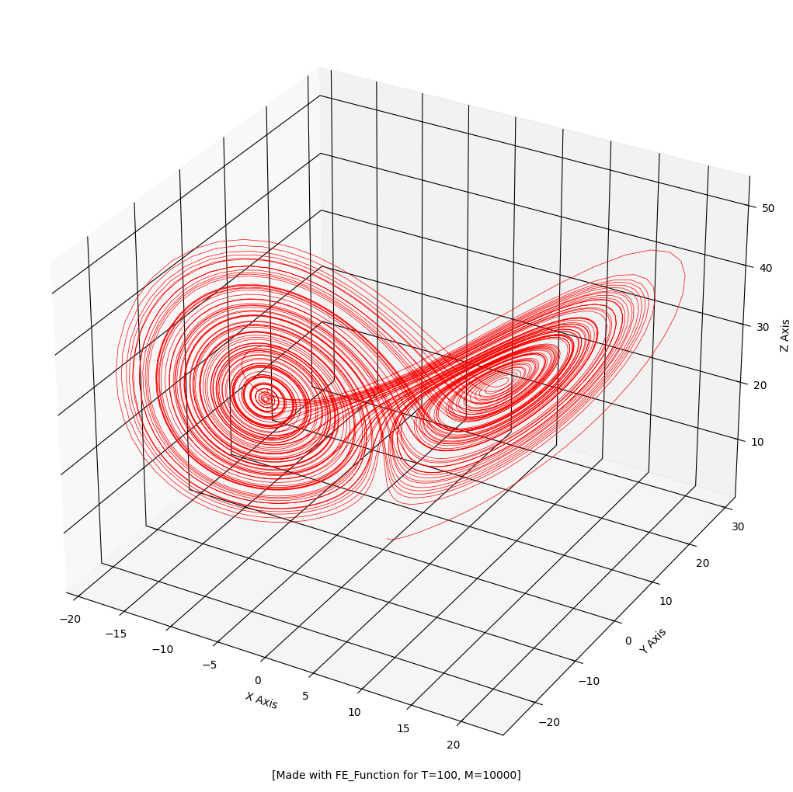
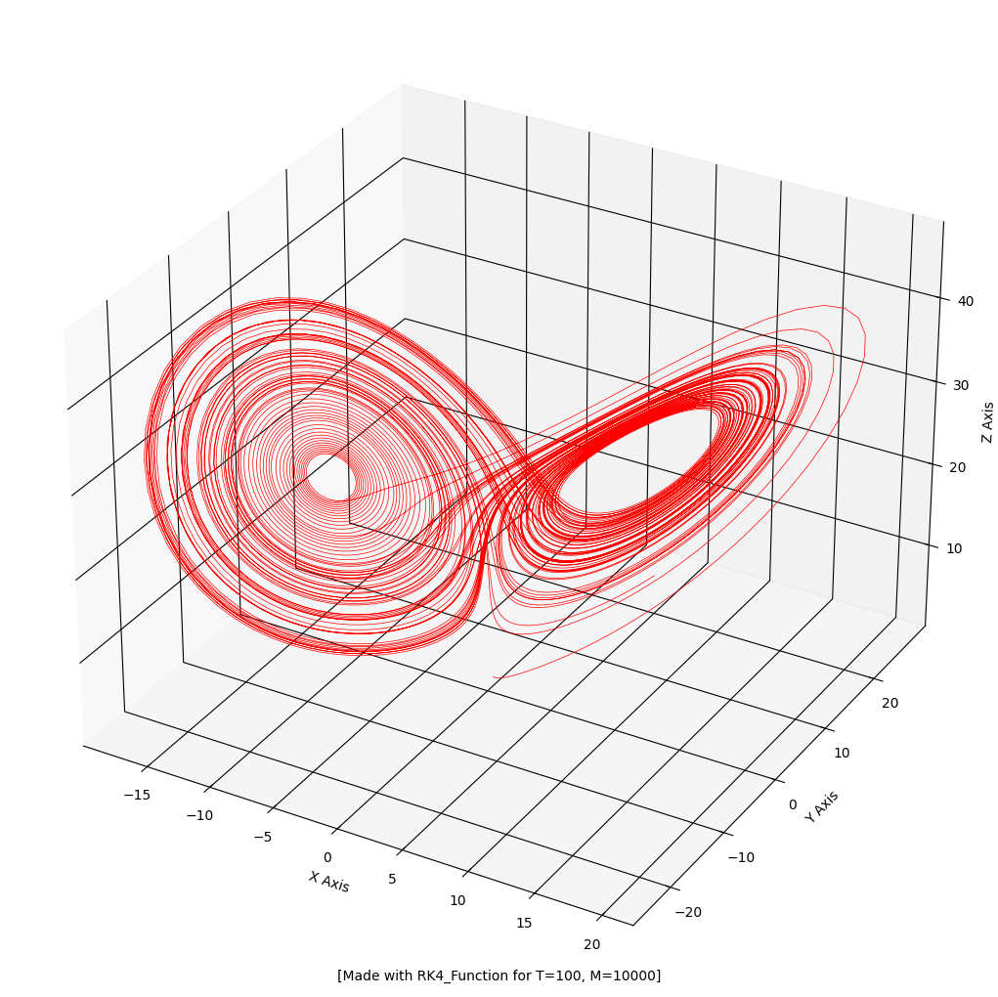
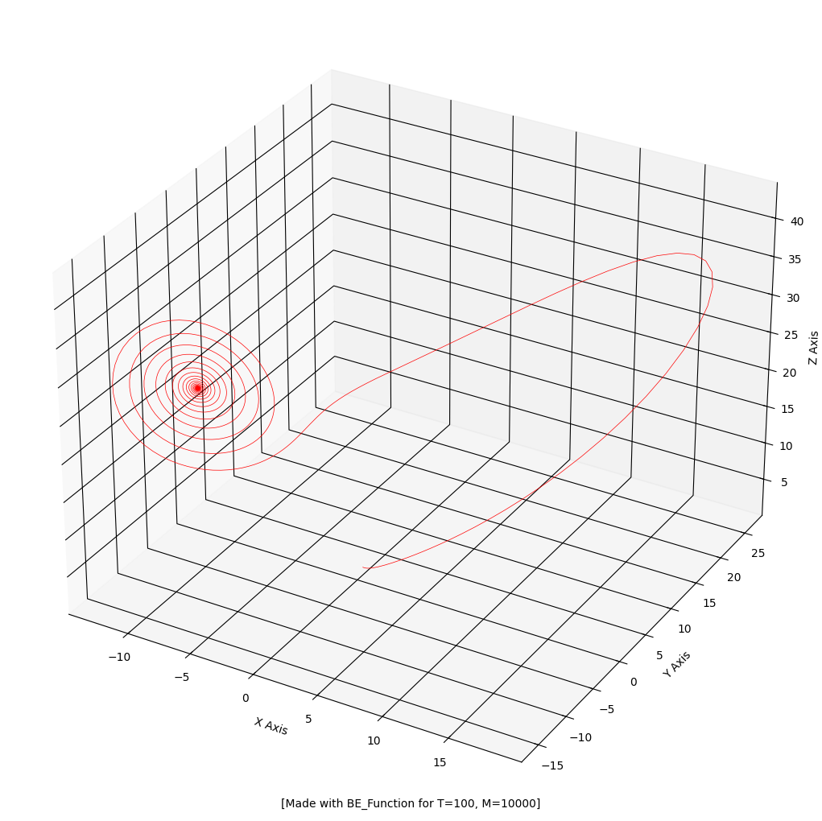
Lorenz system
Forward Euler
4th order Runge-Kutta
Backward Euler (with Newton)
h=0.01
h=0.01
h=0.01
Numerical methods for solving systems of chaotic first-order differential equations
Φλωριάς Παπαδόπουλος

Slide 8
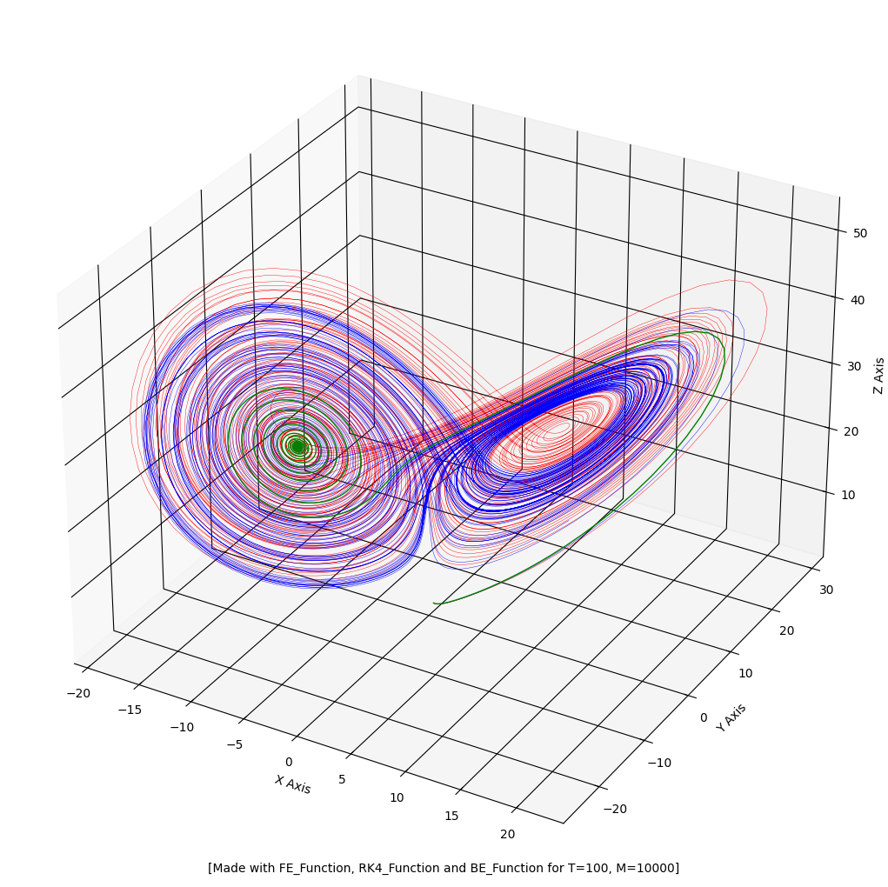
Lorenz system
Forward Euler
4th order Runge-Kutta
Backward Euler (with Newton)
Numerical methods for solving systems of chaotic first-order differential equations
Φλωριάς Παπαδόπουλος

Slide 9
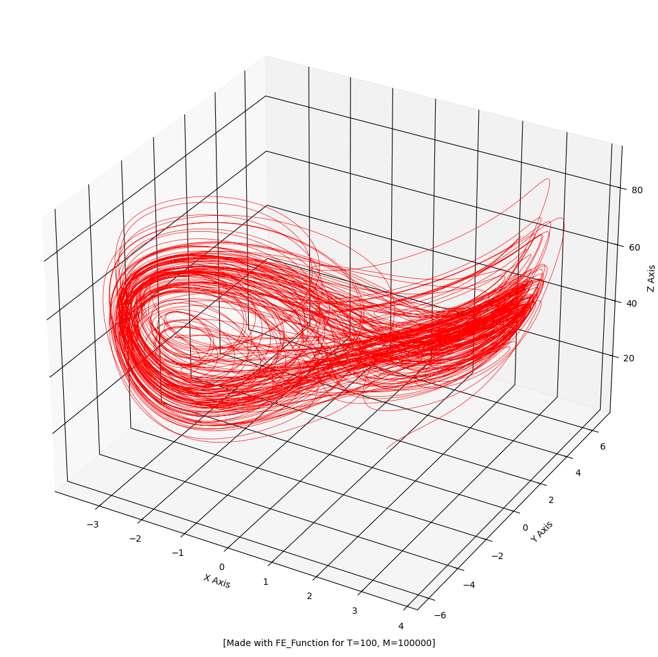
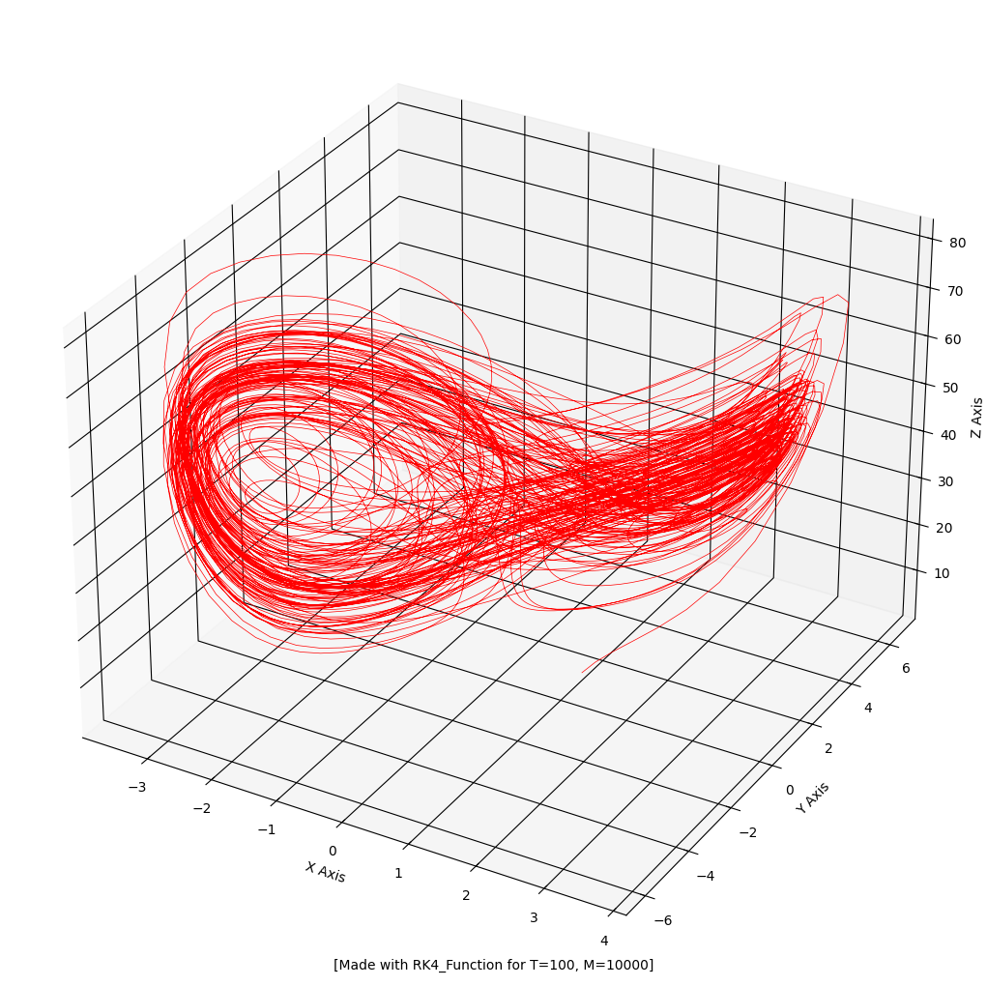
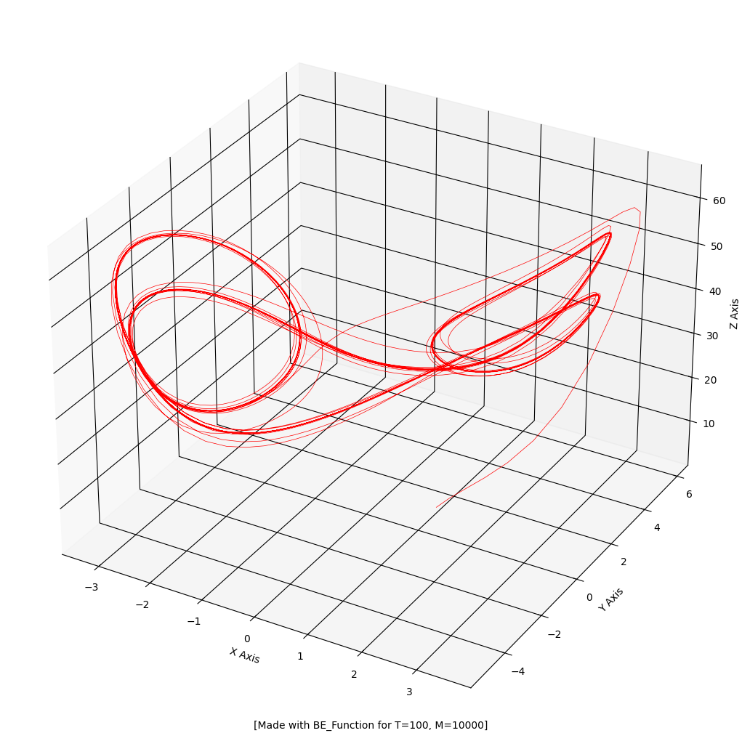
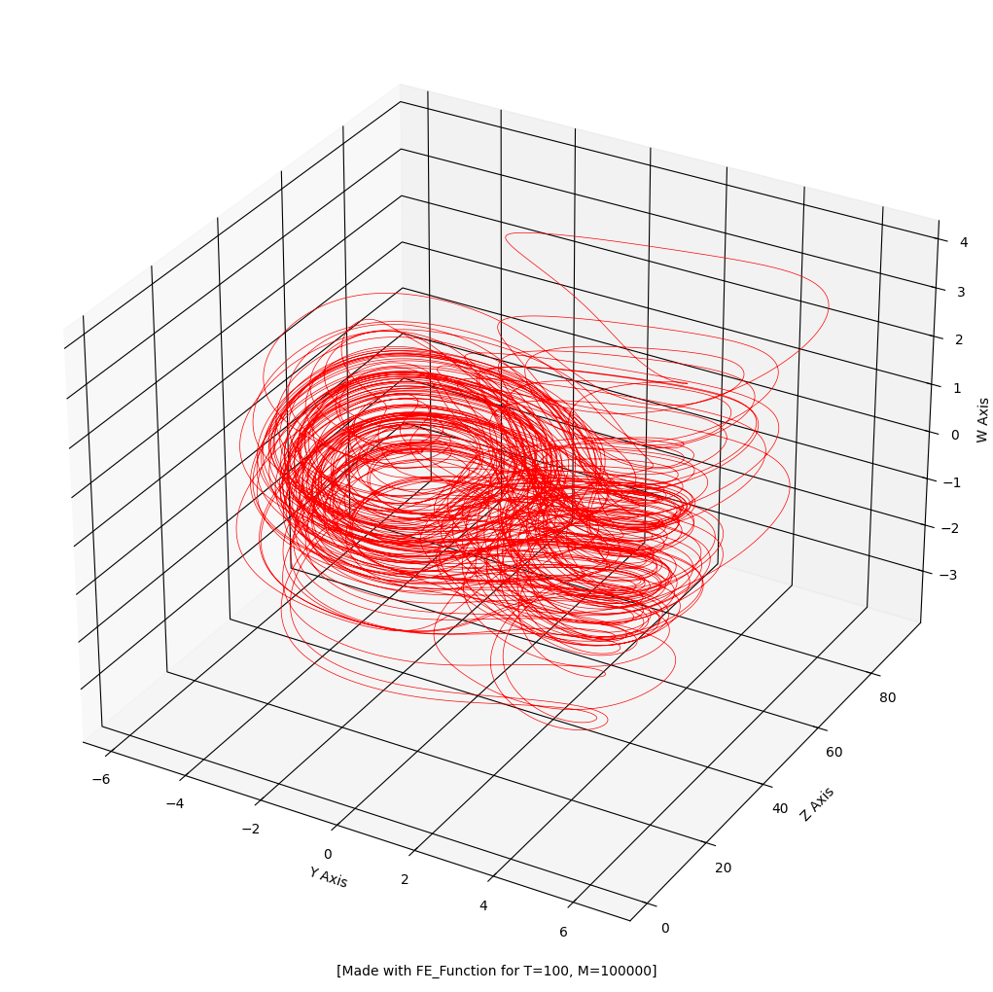
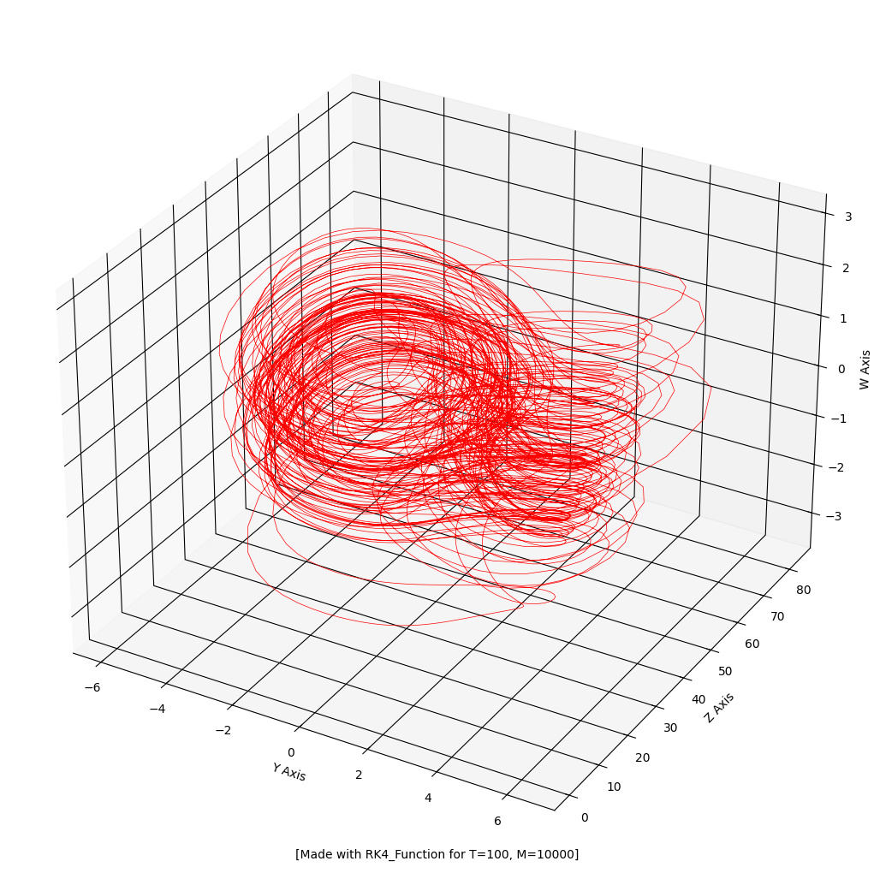
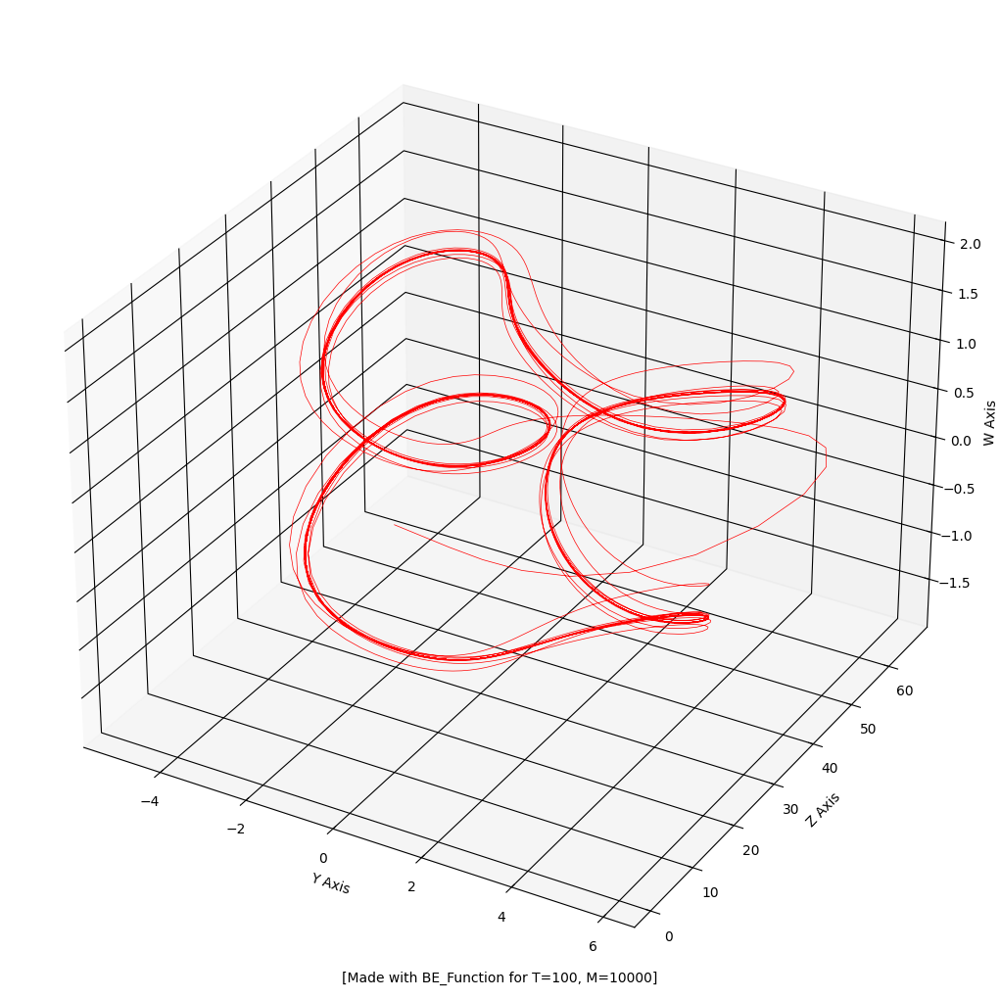
4d Lorenz system
xyz:
h=0.001!
h=0.01
h=0.01
yzw:
Forward Euler
4th order Runge-Kutta
Backward Euler (with Newton)
Numerical methods for solving systems of chaotic first-order differential equations
Φλωριάς Παπαδόπουλος

Slide 10
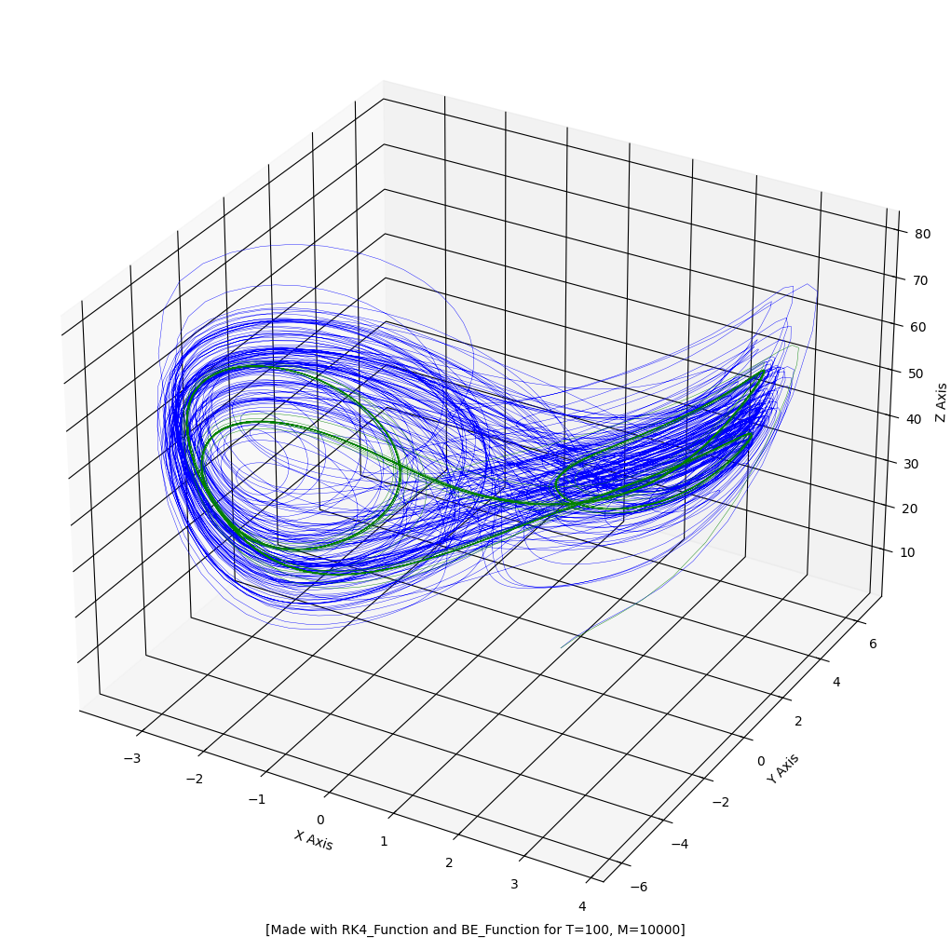
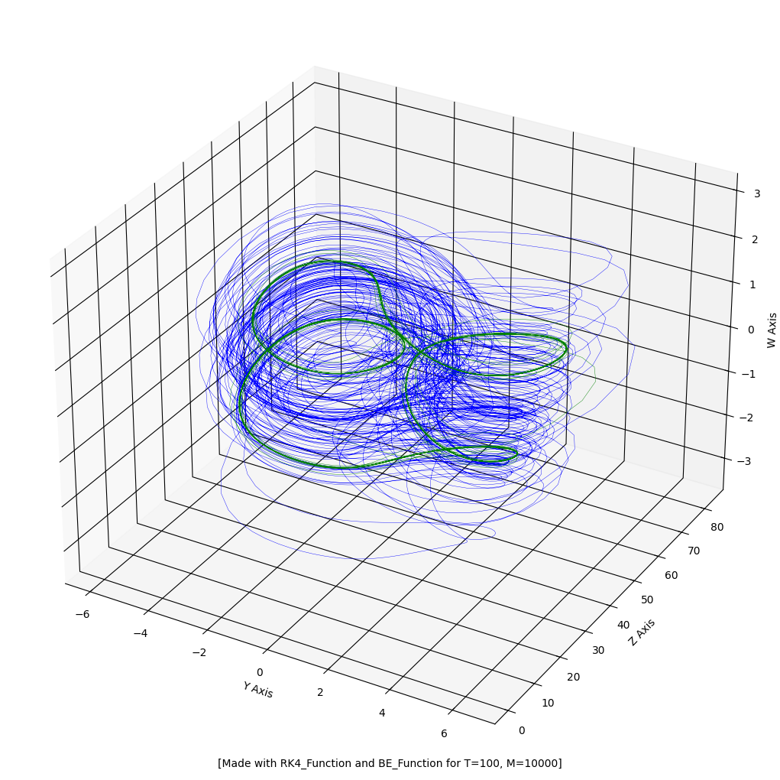
4d Lorenz system
xyz
yzw
Forward Euler
4th order Runge-Kutta
Backward Euler (with Newton)
Numerical methods for solving systems of chaotic first-order differential equations
Φλωριάς Παπαδόπουλος

Slide 11
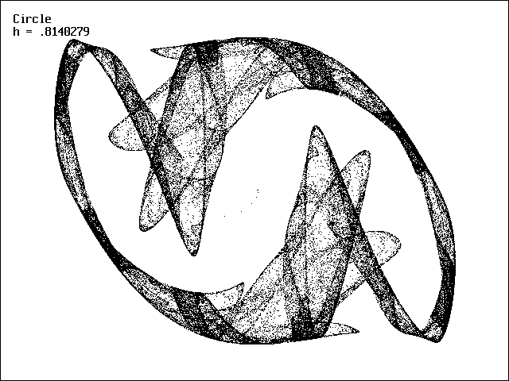
Descending further into chaos

Slide 12
Chen system
$$\left\{\begin{aligned}x^{′}\left(t\right)=a\left(y\left(t\right)−x\left(t\right)\right)ww;;;;;;,,,,ww \\ y^{′}\left(t\right)=\left(c−a\right)x\left(t\right)−x\left(t\right)z\left(t\right)+cy(t) \\ z^{′}\left(t\right)=x\left(t\right)y\left(t\right)−bz\left(t\right)kkkkkk,,qww\end{aligned}\right.$$
$$a=40ss.$$
$$b=3,,,s$$
$$c=28m$$
Numerical methods for solving systems of chaotic first-order differential equations
Φλωριάς Παπαδόπουλος

Slide 13
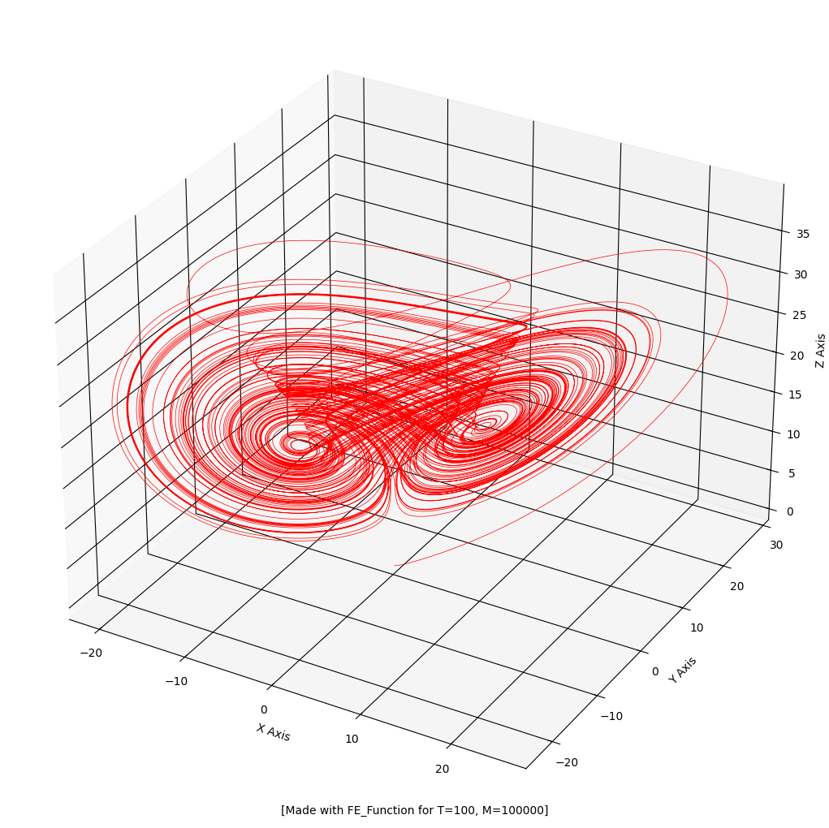
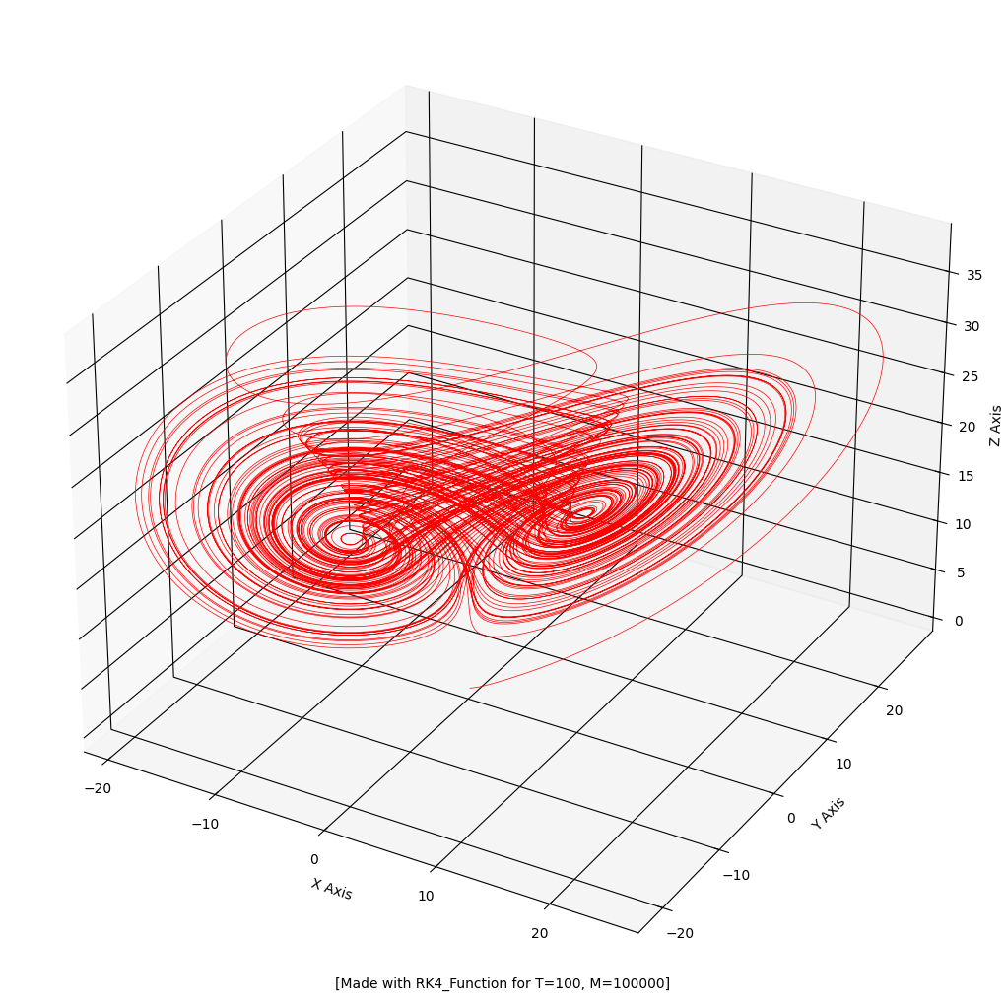
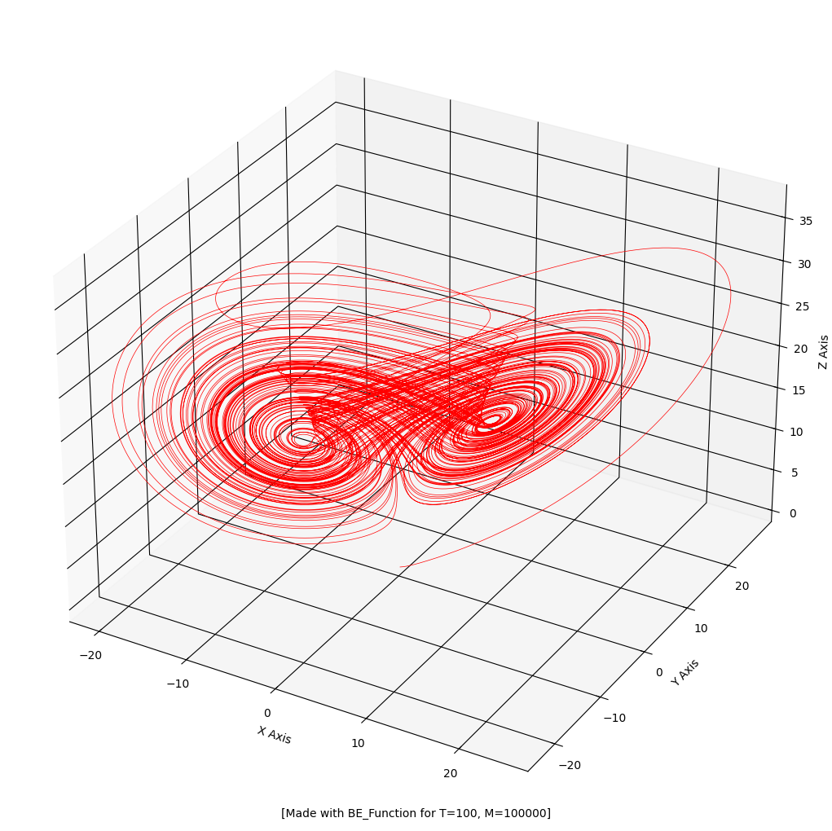
Chen system
Forward Euler
4th order Runge-Kutta
Backward Euler (with Newton)
h=0.001
h=0.001
h=0.001
Numerical methods for solving systems of chaotic first-order differential equations
Φλωριάς Παπαδόπουλος

Slide 14
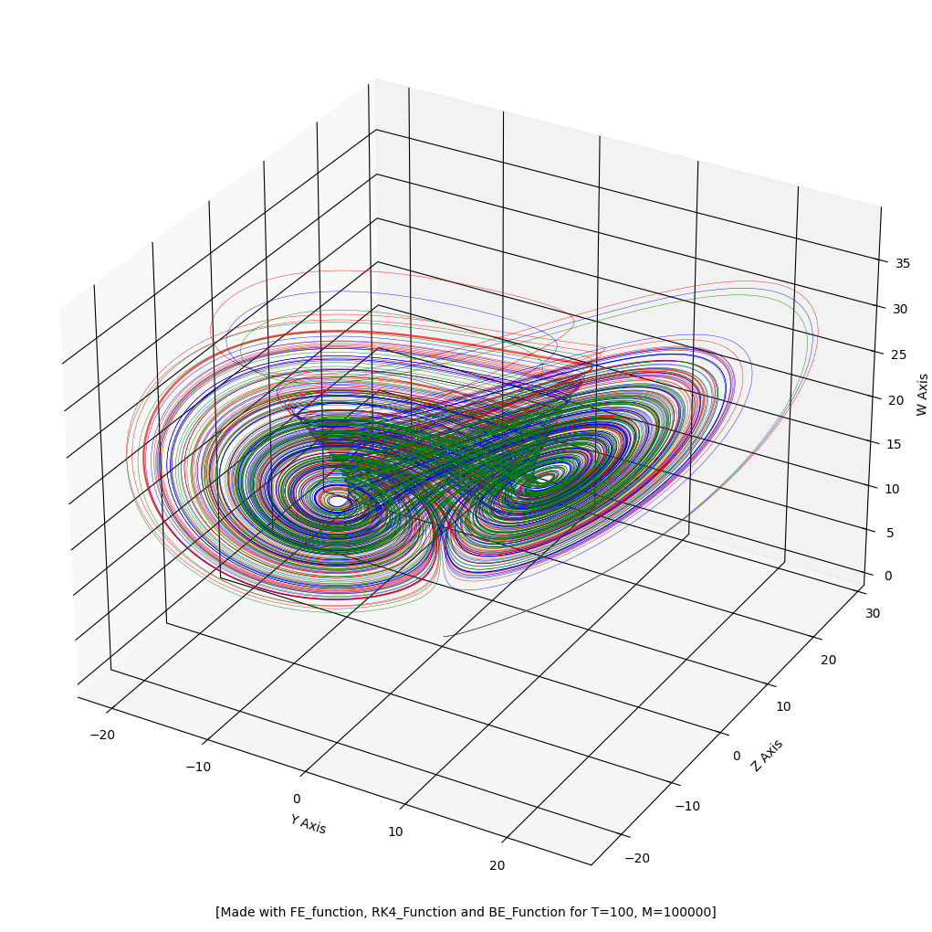
Chen system
Forward Euler
4th order Runge-Kutta
Backward Euler (with Newton)
Numerical methods for solving systems of chaotic first-order differential equations
Φλωριάς Παπαδόπουλος

Slide 15
Nose-Hoover Oscillator
$$\left\{\begin{aligned}x^{′}\left(t\right)=y\left(t\right),,;,,,,,;,k,,ww \\ y^{′}\left(t\right)=−x\left(t\right)−y\left(t\right)z\left(t\right),,k \\ z^{′}\left(t\right)={({y\left(t\right)}^{2}−1)}/q,,,,,,,\end{aligned}\right.$$
$$q=10s$$
Numerical methods for solving systems of chaotic first-order differential equations
Φλωριάς Παπαδόπουλος

Slide 16
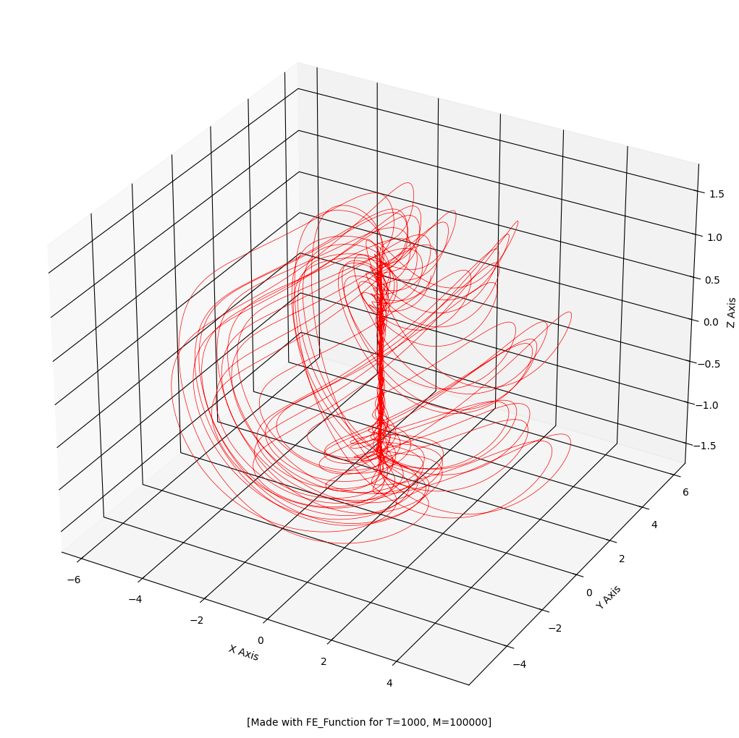
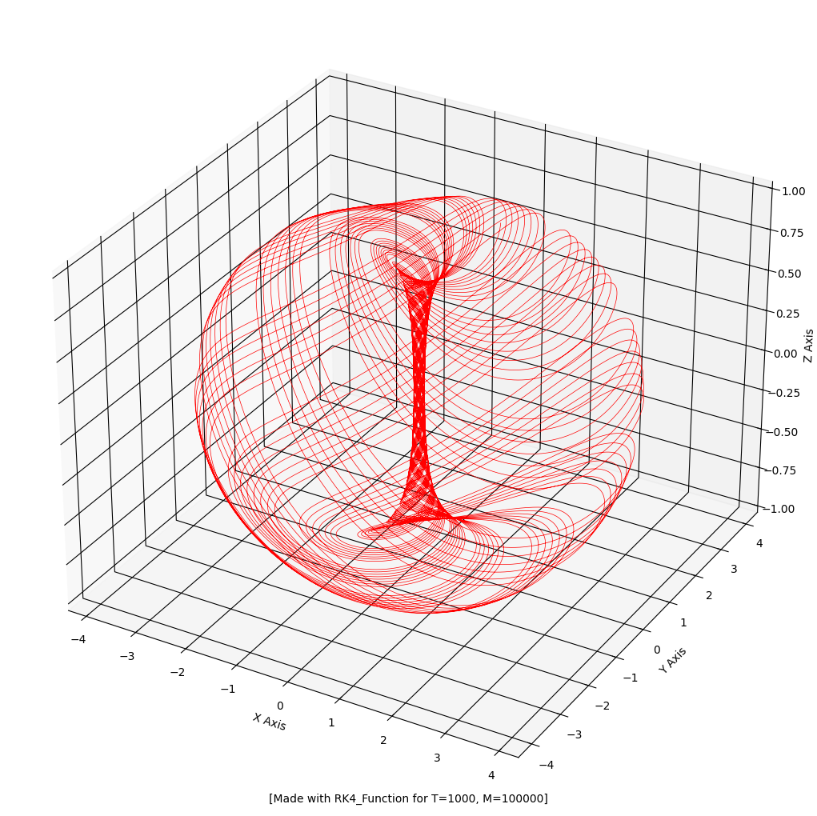
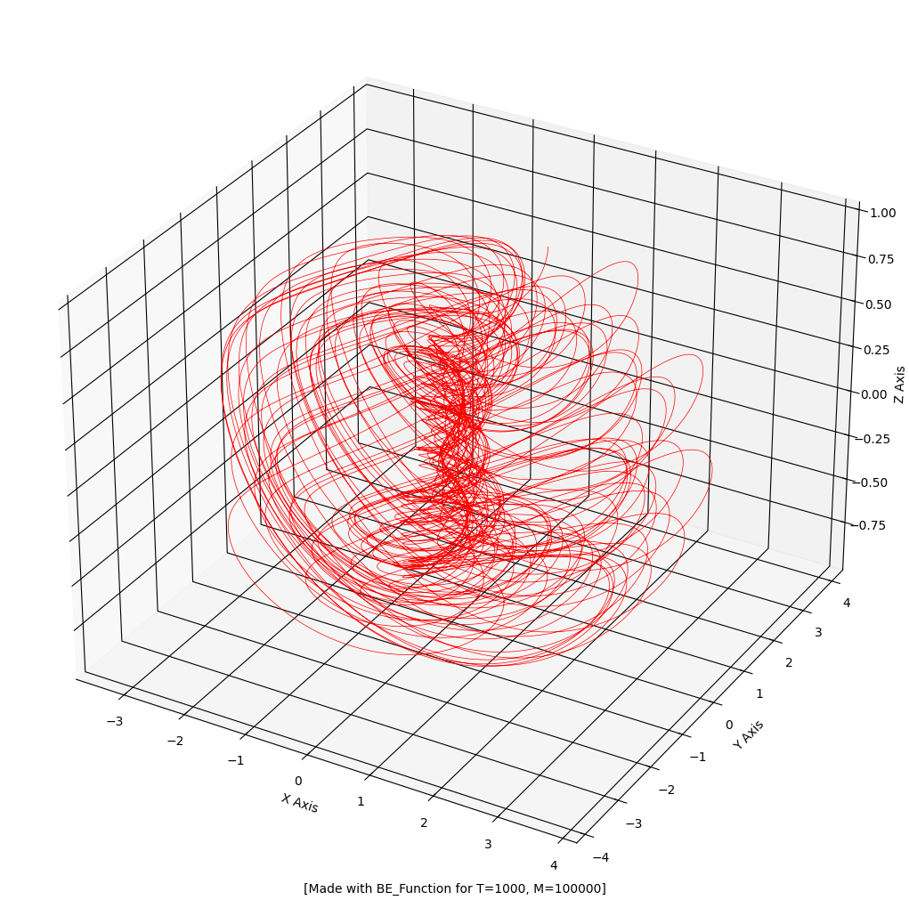
Nose-Hoover Oscillator
Forward Euler
4th order Runge-Kutta
Backward Euler (with Newton)
h=0.01
h=0.01
h=0.01
Numerical methods for solving systems of chaotic first-order differential equations
Φλωριάς Παπαδόπουλος

Slide 17
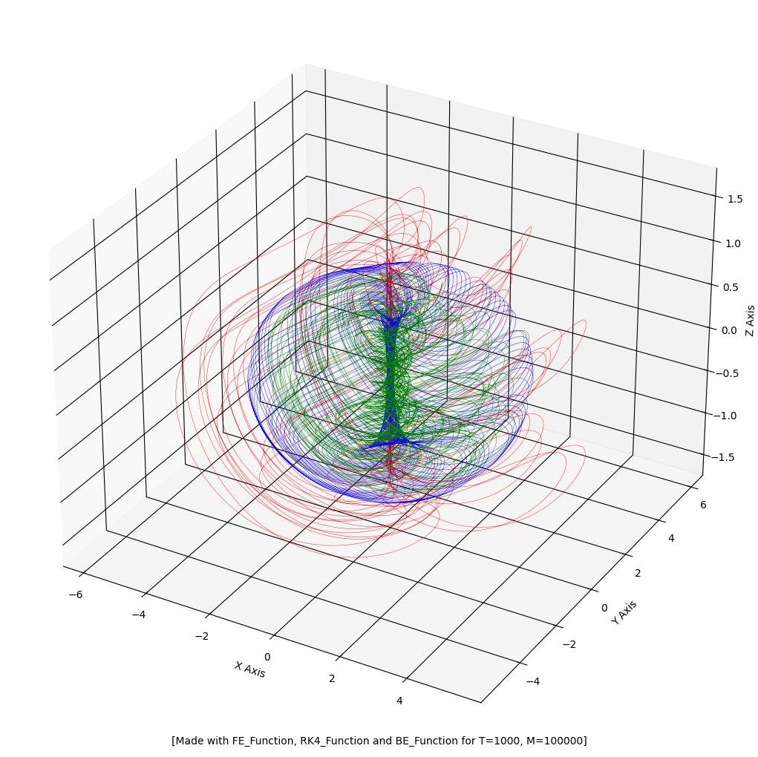
Nose-Hoover Oscillator
Forward Euler
4th order Runge-Kutta
Backward Euler (with Newton)
Numerical methods for solving systems of chaotic first-order differential equations
Φλωριάς Παπαδόπουλος

Slide 18
Sprott-Jafari system
$$\left\{\begin{aligned}x^{′}\left(t\right)=y\left(t\right)ww;;ppppppppppp,;;;;,,,,ww \\ y^{′}\left(t\right)=−x\left(t\right)+y\left(t\right)z\left(t\right)pppppp,,ppppppp \\ z^{′}\left(t\right)=z\left(t\right)+a{x(t)}^{2}−{y\left(t\right)}^{2}−b,,,k,,qww\end{aligned}\right.$$
$$a=8.894$$
$$b=4,$$
Numerical methods for solving systems of chaotic first-order differential equations
Φλωριάς Παπαδόπουλος

Slide 19
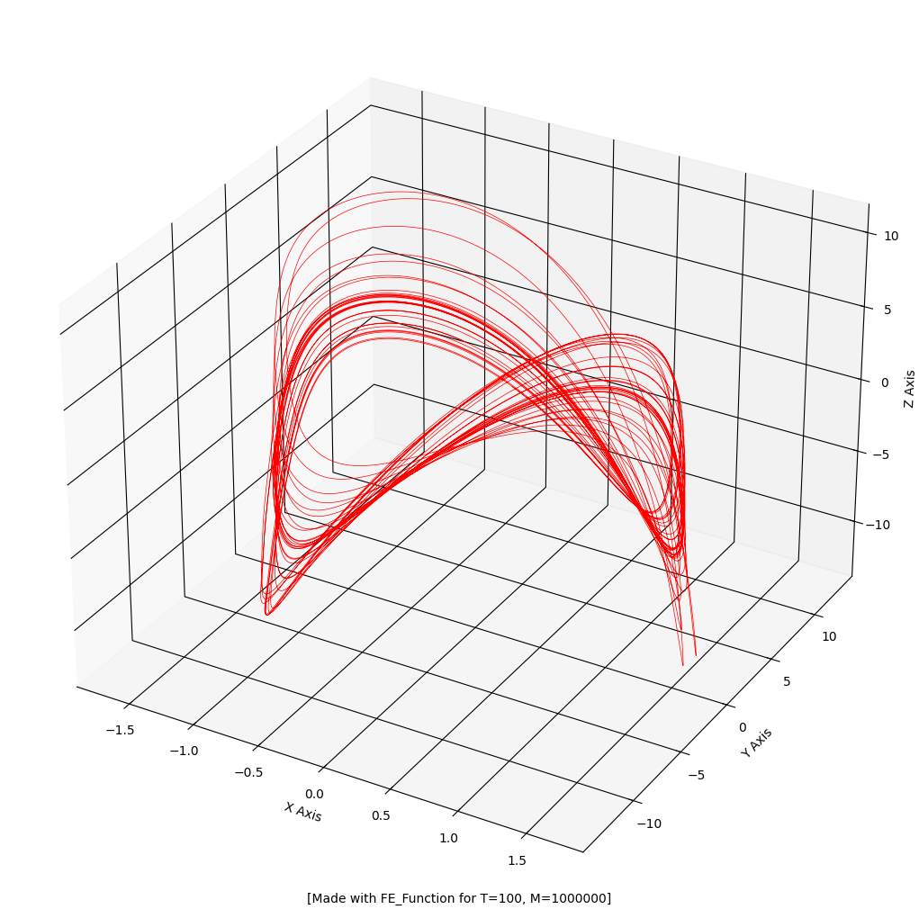
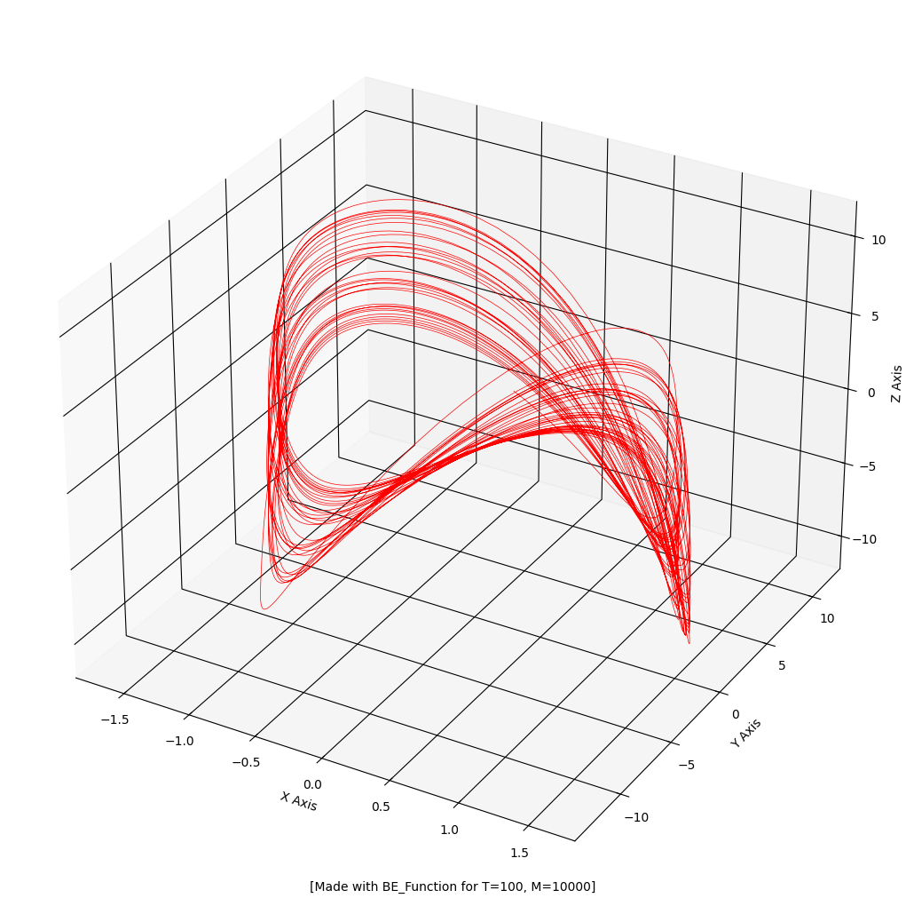
Sprott-Jafari system
Forward Euler
4th order Runge-Kutta
Backward Euler (with Newton)
h=0.0001!
h=0.01
h=0.01
Numerical methods for solving systems of chaotic first-order differential equations
Φλωριάς Παπαδόπουλος

Slide 20
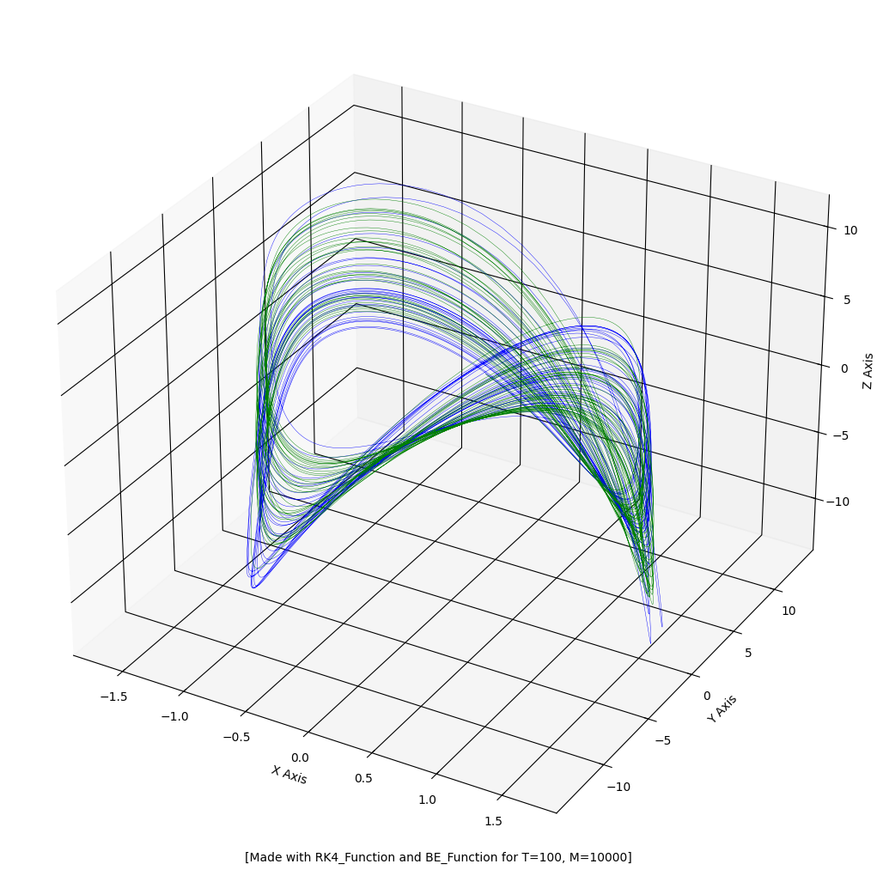
Sprott-Jafari system
Forward Euler
4th order Runge-Kutta
Backward Euler (with Newton)
Numerical methods for solving systems of chaotic first-order differential equations
Φλωριάς Παπαδόπουλος

Slide 21
Animation
File: chaotic_presentation.ipynb
Numerical methods for solving systems of chaotic first-order differential equations
Φλωριάς Παπαδόπουλος

